Slide 1


Causally Regularized Machine learning
Peng Cui, Tsinghua University
Kun Kuang, Zhejiang University
Bo Li, Tsinghua University

Slide 2

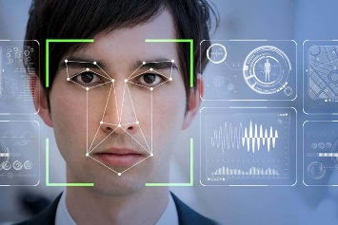
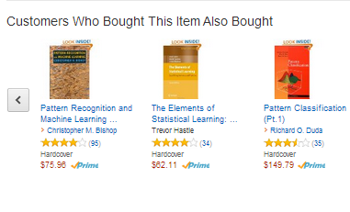

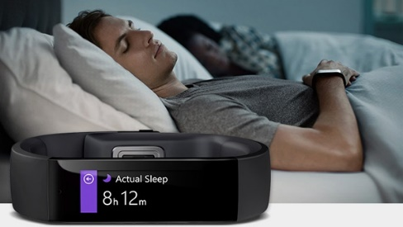


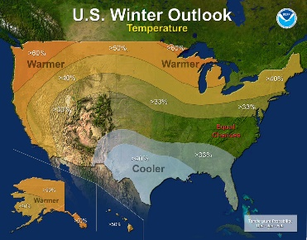
ML techniques are impacting our life
A day in our life with ML techniques
8:00 am
10:00 am
6:00 pm
8:30 am
4:00 pm
8:00 pm

Slide 3

Now we are stepping into risk-sensitive areas
Shifting from Performance Driven to Risk Sensitive

Slide 4
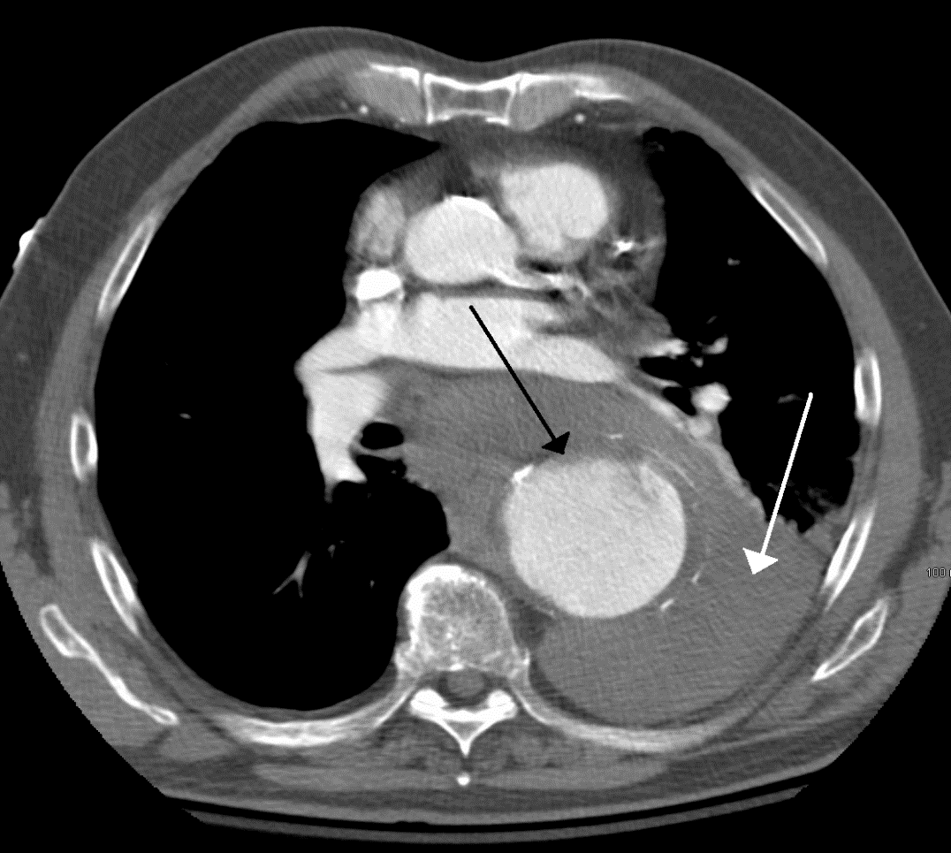

Problems of today’s ML - Explainability
Most machine learning models are black-box models
Unexplainable
Human in the loop
Health Military Finance Industry

Slide 5
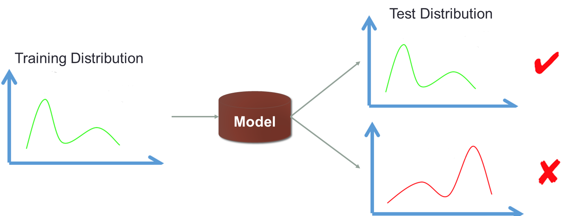
Problems of today’s ML - Stability
Most ML methods are developed under I.I.D hypothesis

Slide 6


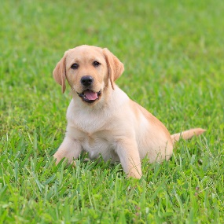


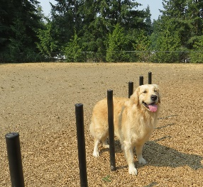


Problems of today’s ML - Stability
Yes
Maybe
No

Slide 7



Problems of today’s ML - Stability
Cancer survival rate prediction
Testing Data
Training Data
City Hospital
Predictive Model
City Hospital
Higher income, higher survival rate.
University Hospital
Survival rate is not so correlated with income.

Slide 8
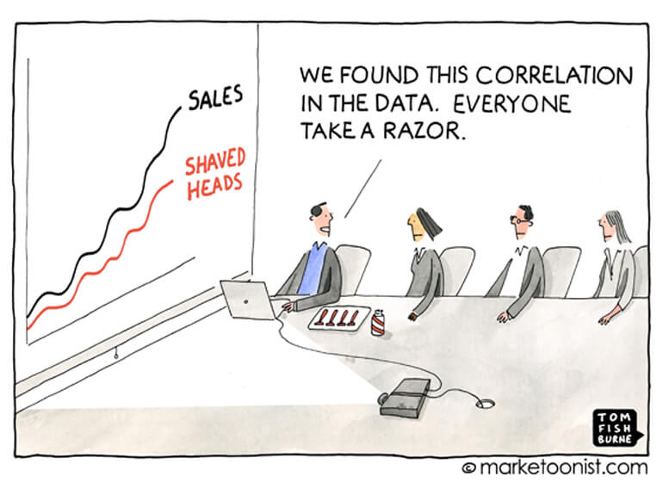
A plausible reason: Correlation
Correlation is the very basics of machine learning.

Slide 9
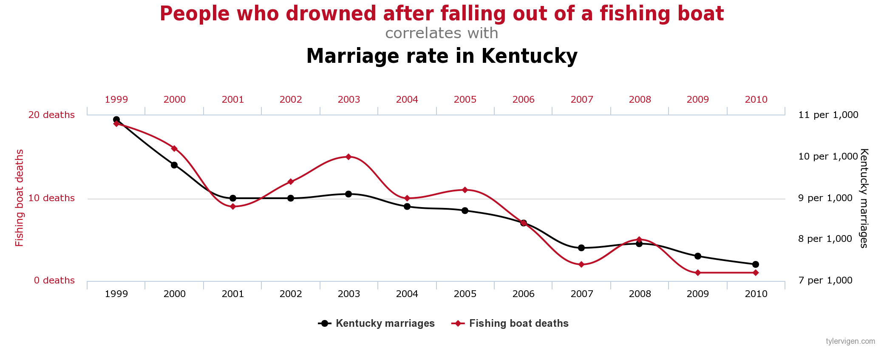
Correlation is not explainable

Slide 10
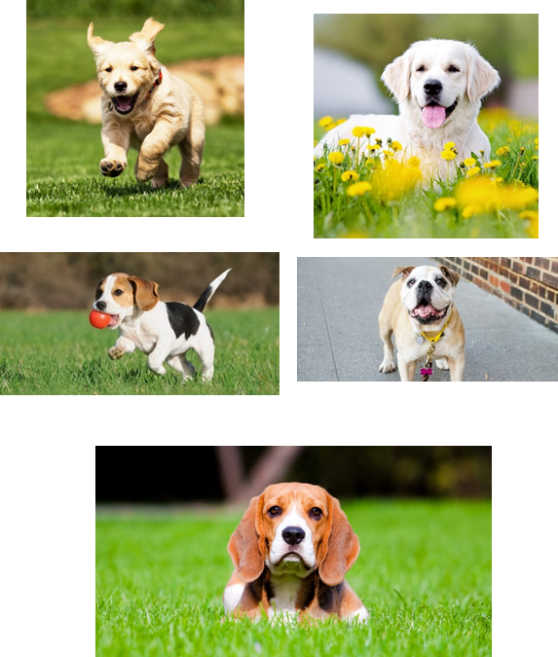
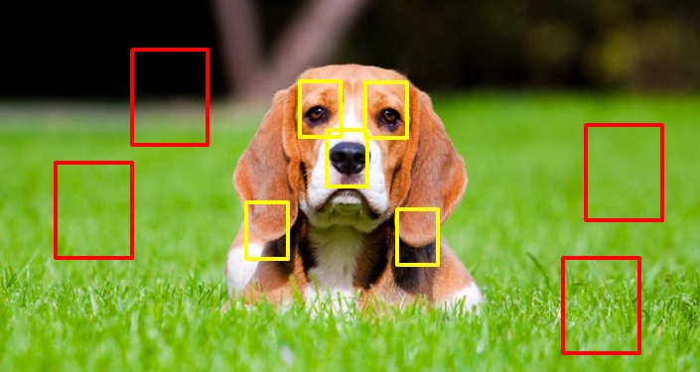
Correlation is ‘unstable’

Slide 11
It’s not the fault of correlation, but the way we use it
Three sources of correlation:
Causation
Causal mechanism
Stable and explainable
Confounding
Ignoring X
Spurious Correlation
Sample Selection Bias
Conditional on S
Spurious Correlation
T
Y
Summer
Ice Cream Sales
X
Income
T
Y
Financial product offer
Accepted
T
Y
Grass
Dog
S
Sample Selection

Slide 12
A Practical Definition of Causality
Definition: T causes Y if and only if
changing T leads to a change in Y,
while keeping everything else constant.
Causal effect is defined as the magnitude by which Y is changed by a unit change in T.
Called the “interventionist” interpretation of causality.
X
T
Y
*Interventionist definition [http://plato.stanford.edu/entries/causation-mani/]

Slide 13
The benefits of bringing causality into learning
Causal Framework
Grass—Label: Strong correlation
Weak causation
Dog nose—Label: Strong correlation
Strong causation
X
T
Y
T：grass
X：dog nose
Y：label
More Explainable and More Stable

Slide 14
The gap between causality and learning
How to evaluate the outcome?
Wild environments
High-dimensional
Highly noisy
Little prior knowledge (model specification, confounding structures)
Targeting problems
Understanding v.s. Prediction
Depth v.s. Scale and Performance
How to bridge the gap between causality and (stable) learning?

Slide 15
Outline
Correlation v.s. Causality
Causal Inference
Stable Learning
NICO: An Image Dataset for Stable Learning
Conclusions

Slide 16
Paradigms - Structural Causal Model
A graphical model to describe the causal mechanisms of a system
Causal Identification with back door criterion
Causal Estimation with do calculus
U
Z
W
T
Y
How to discover the causal structure?

Slide 17
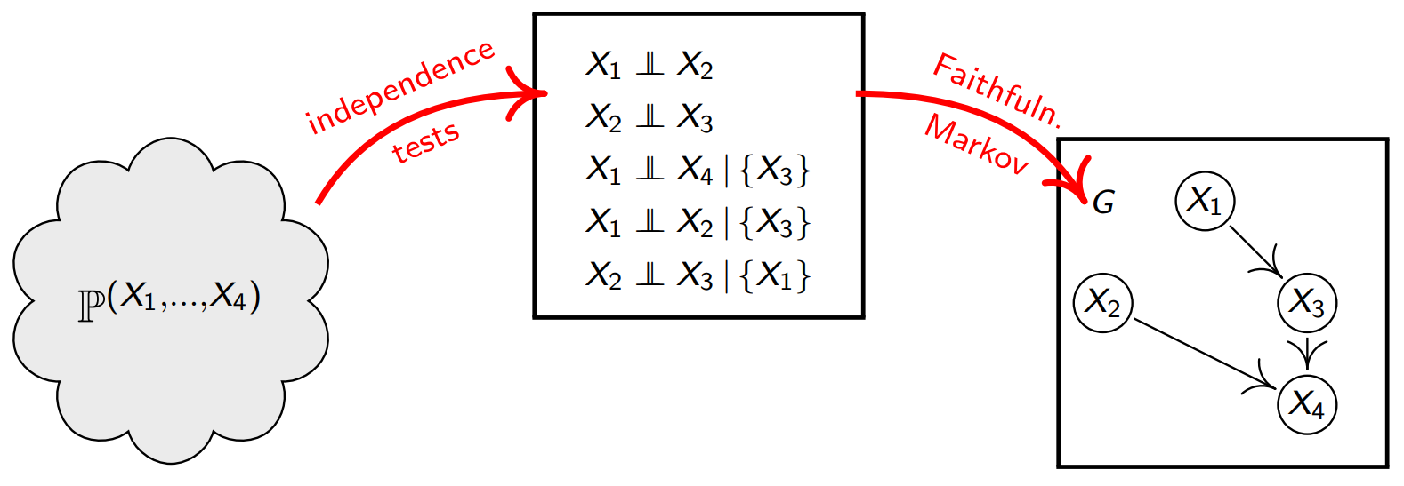
Paradigms – Structural Causal Model
Causal Discovery
Constraint-based: conditional independence
Functional causal model based
A generative model with strong expressive power.
But it induces high complexity.

Slide 18
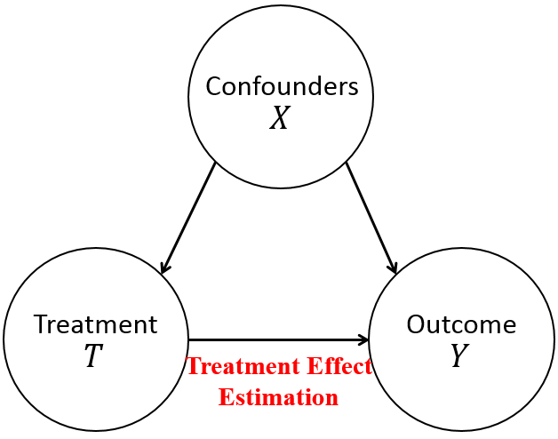
Paradigms - Potential Outcome Framework
A simpler setting
Suppose the confounders of T are known a priori
The computational complexity is affordable
Under stronger assumptions
E.g. all confounders need to be observed
More like a discriminative way to estimate treatment’s partial effect on outcome.

Slide 19

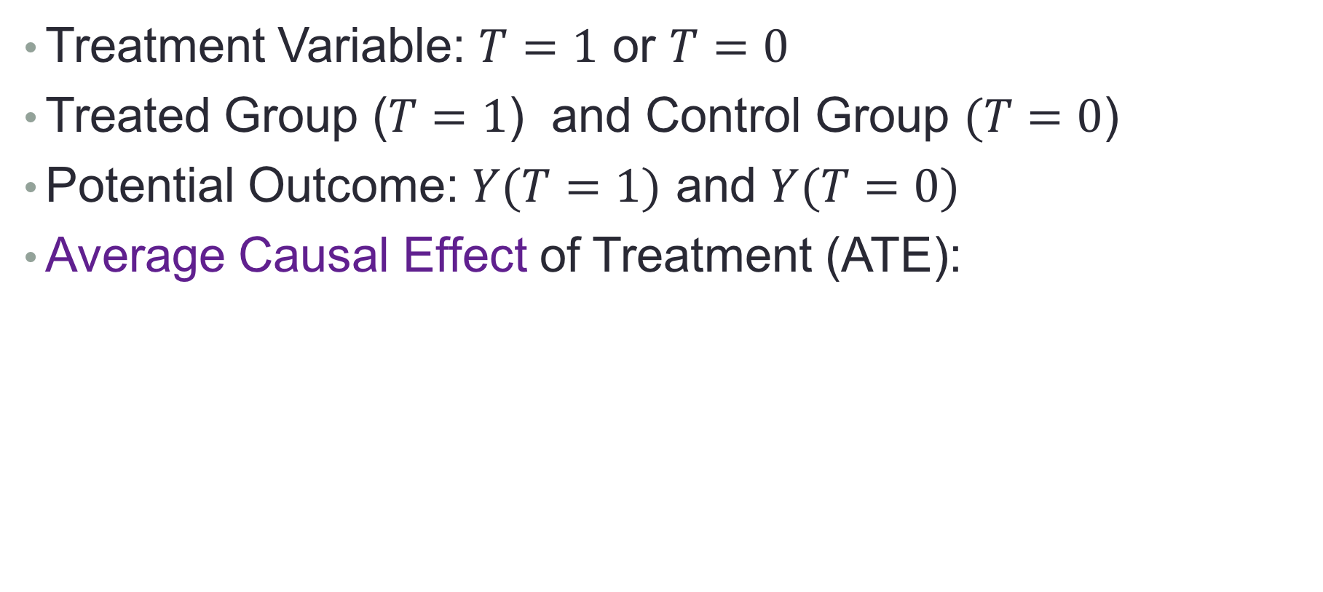
Causal Effect Estimation
Treatment Variable: $T=1$ or $T=0$
Treated Group ($T=1$) and Control Group $(T=0$)
Potential Outcome: $Y(T=1)$ and $Y(T=0)$
Average Causal Effect of Treatment (ATE):
$$ATE=E[Y\left(T=1\right)−Y\left(T=0\right)]$$
Notes:
Basic concepts
placebo

Slide 20
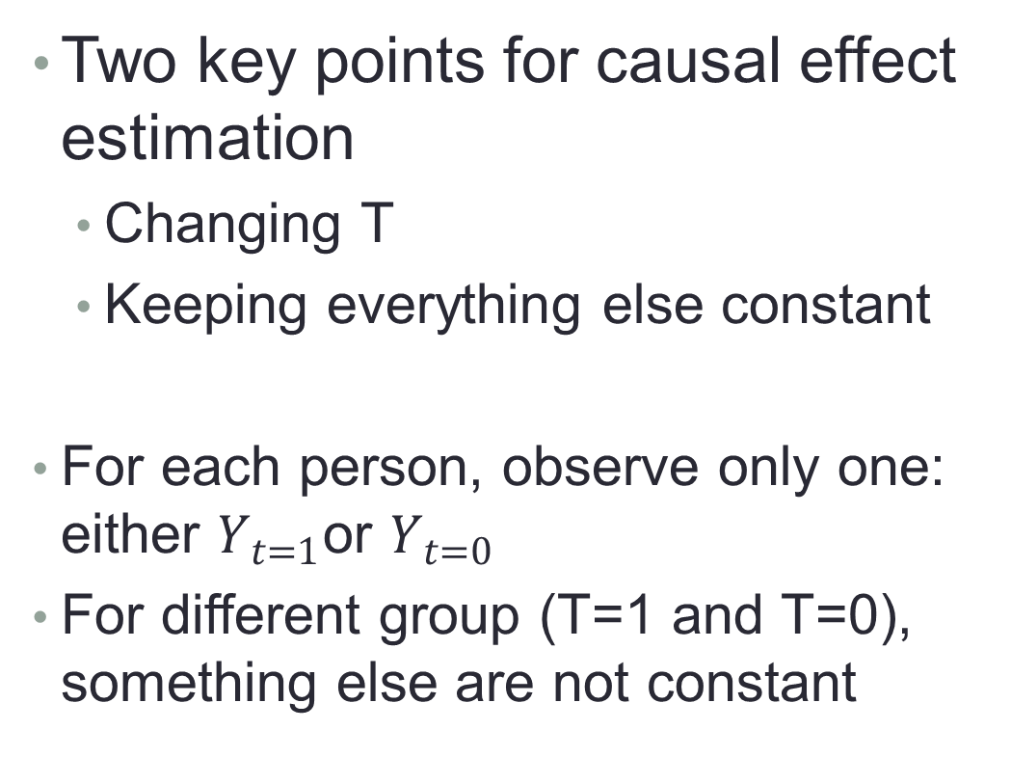
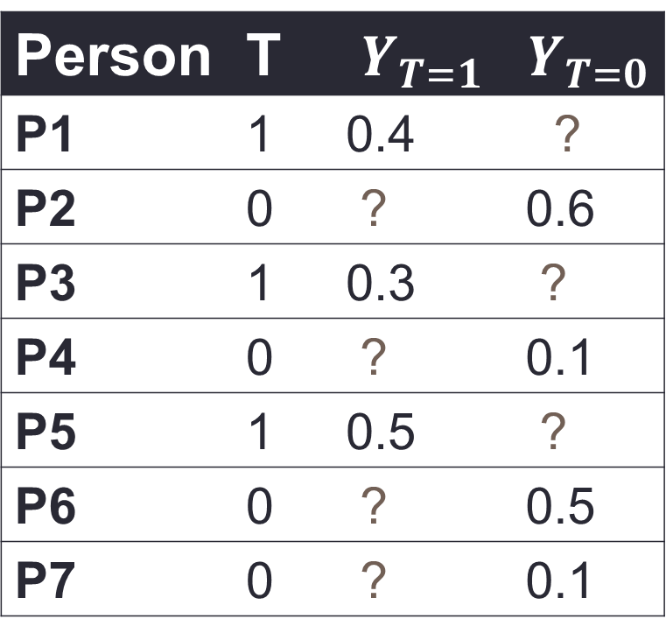
Counterfactual Problem
Two key points for causal effect estimation
Changing T
Keeping everything else constant
For each person, observe only one: either $Y_{t=1}$or $Y_{t=0}$
For different group (T=1 and T=0), something else are not constant
Person | T | $$Y_{T=1}$$ | $$Y_{T=0}$$
P1 | 1 | 0.4 | ?
P2 | 0 | ? | 0.6
P3 | 1 | 0.3 | ?
P4 | 0 | ? | 0.1
P5 | 1 | 0.5 | ?
P6 | 0 | ? | 0.5
P7 | 0 | ? | 0.1
Notes:
You can never step into the same river twice.

Slide 21



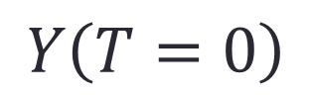
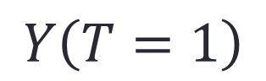
Ideal Solution: Counterfactual World
Reason about a world that does not exist
Everything in the counterfactual world is the same as the real world, except the treatment
$$Y\left(T=1\right)$$
$$Y\left(T=0\right)$$

Slide 22





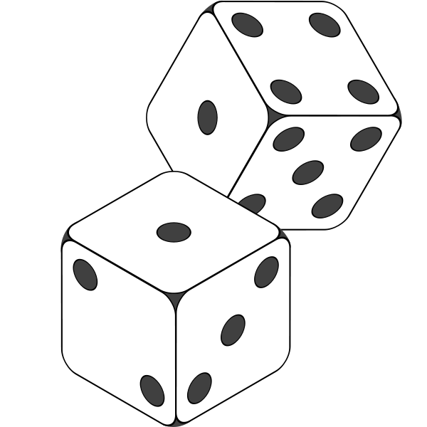



Randomized Experiments are the “Gold Standard”
What can we do when an experiment is not possible?
Observational Studies!
Drawbacks of randomized experiments:
Cost
Unethical
Unrealistic
Notes:
Example and concept for confounding

Slide 23
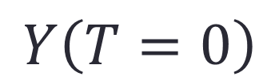
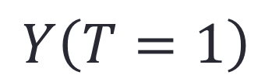
Recap: Causal Effect and Potential Outcome
Two key points for causal effect estimation
Changing T
Keeping everything else (X) constant
Counterfactual Problem
Ideal Solution: Counterfactual World
“Gold Standard”: Randomized Experiments
We will discuss other solutions in next Section.
$$Y\left(T=1\right)$$
or
$$Y\left(T=0\right)$$

Slide 24
Outline
Correlation v.s. Causality
Causal Inference
Methods for Causal Inference
Stable Learning
NICO: An Image Dataset for Stable Learning
Conclusions

Slide 25
Causal Inference with Observational Data
Average Treatment Effect (ATE) represents the mean (average) difference between the potential outcome of units under treated (T=1) and control (T=0) status.
Treated (T=1): taking a particular medication
Control (T=0): not taking any medications
ATE: the causal effect of the particular medication
$$ATE=E[Y\left(T=1\right)−Y\left(T=0\right)]$$
Notes:
As introduced before, under potential outcome framework, the average causal effect or average treatment effect can be defined as the mean difference between the potential outcome of units under treated and control status, where the Y(1) and Y(0) represent the potential outcome of units with treatment status as treated T=1 and control T=1, respectively.
For example, we want to estimate the causal effect of a particular medication, where treated status means taking that medication, control status means not taking any medications, then the ATE represents the causal effect of that medication.

Slide 26
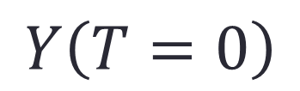
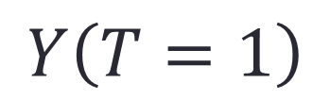
Causal Inference with Observational Data
Counterfactual Problem:
Can we estimate ATE by directly comparing the average outcome between treated and control groups?
Yes with randomized experiments (X are the same)
No with observational data (X might be different)
Two key points:
Changing T (T=1 and T=0)
Keeping everything else (Confounder X) constant
$$Y\left(T=1\right)$$
or
$$Y\left(T=0\right)$$
Balancing Confounders’ Distribution
Notes:
From the definition of ATE, we know there is a counterfactual problem. That is, for each unit, we can only observe one of two potential outcomes, treated or control, not both.
So there is a question, under the counterfactual problem, ca we estimate …
It depends on your data. If your data are from randomized experiments, the answer is YES.
Do you still remember the two key points for estimating causal effect: one is changing T, this condition is satisfied since we have two different value of T; the other is keeping everything else constant, that is the confounder should be the same between group T=1 and Groups T=0, this condition can be guaranteed by randomized experiments. Hence, we can directly comparing .. If our data are from randomized experiments.
But we cannot if our data are observational data or historical data. In observational data, we also have units with different treatment T, but their treatment status might be affected by their other features, we say confounders X, leading to the different distribution on confounders.
For example, for a very expensive medication, taking or not majorly depends on the patients’ income, leading to the distribution of income variable become different between treated and control groups.
Hence, if we want to estimate the causal effect from observational data, we need to balance confounders’ distribution.

Slide 27
Methods for Causal Inference
Matching
Propensity Score Based Methods
Propensity Score Matching
Inverse of Propensity Weighting (IPW)
Doubly Robust
Data-Driven Variable Decomposition (D²VD)
Directly Confounder Balancing
Entropy Balancing
Approximate Residual Balancing
Differentiated Confounder Balancing (DCB)
Notes:
To balance confounders’ distribution, there are three main kind of methods, including matching methods, propensity score based methods, and directly confounder balancing approaches.

Slide 28
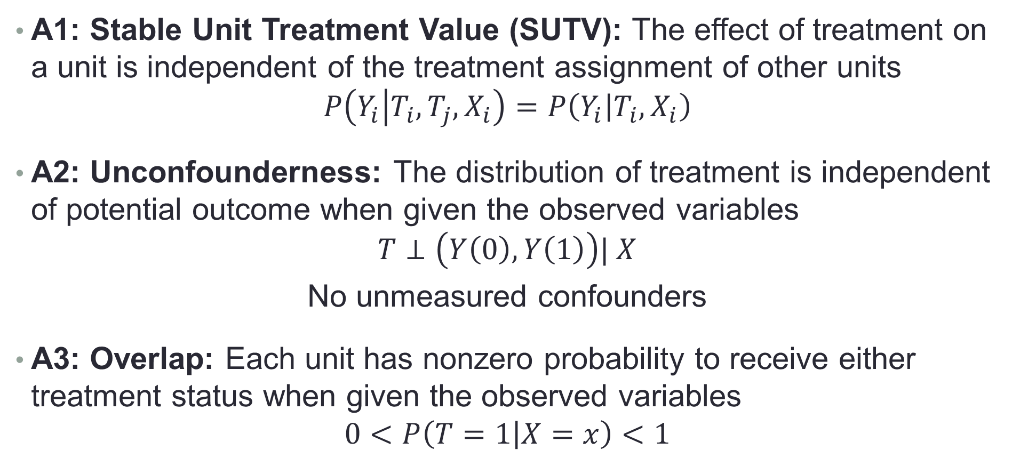
Assumptions of Causal Inference
A1: Stable Unit Treatment Value (SUTV): The effect of treatment on a unit is independent of the treatment assignment of other units
$$P\left(Y_{i} | T_{i},T_{j},X_{i}\right)=P\left(Y_{i} | T_{i},X_{i}\right)$$
A2: Unconfounderness: The distribution of treatment is independent of potential outcome when given the observed variables
$$T⊥\left(Y\left(0\right),Y\left(1\right)\right)| X$$
No unmeasured confounders
A3: Overlap: Each unit has nonzero probability to receive either treatment status when given the observed variables
$$0<P\left(T=1 | X=x\right)<1$$
Notes:
Before introducing the details of each method, we firstly introduce the assumptions for causal inference in observational studies.
The first assumption is … For example, the causal effect of a particular medication on me is independent with whether peng take a medication or not.
The second assumption is Unconfounderness, we also called as ignorability. That is … This assumption demonstrate that all confounders are observed, there are no unmeasured confounders.
The third assumption is overlap, that is …
With these three assumptions, we can precisely estimate causal effect from observational data if we can balance all confounders.

Slide 29
Methods for Causal Inference
Matching
Propensity Score Based Methods
Propensity Score Matching
Inverse of Propensity Weighting (IPW)
Doubly Robust
Data-Driven Variable Decomposition (D²VD)
Directly Confounder Balancing
Entropy Balancing
Approximate Residual Balancing
Differentiated Confounder Balancing
Notes:
Under above assumptions, we will first introduce the matching method for causal inference next.

Slide 30

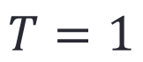
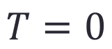
Matching
$$T=0$$
$$T=1$$
Notes:
In observational data, we have units from both treated and control, but their confounders’ distribution might be different. Therefore, we cannot estimate the causal effect by directly comparing their average outcome.

Slide 31
Matching
Notes:
To balance the confounders’ distribution between treated and control groups, matching method propose to match unit i with unit j if they have similar features but different treatment status.
In the carton example, we use the shape and color to demonstrate the patients’ features
Then, for each patient without taking medication, we find a patient that taking the medication but has similar feature to match.
Similarly, for each patient with taking the medication, we find a patient that not taking medication but has similar feature to match.
As for those patients that have no suitable patient to match, we just discard their data.

Slide 32
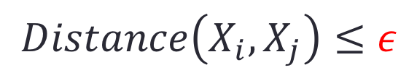
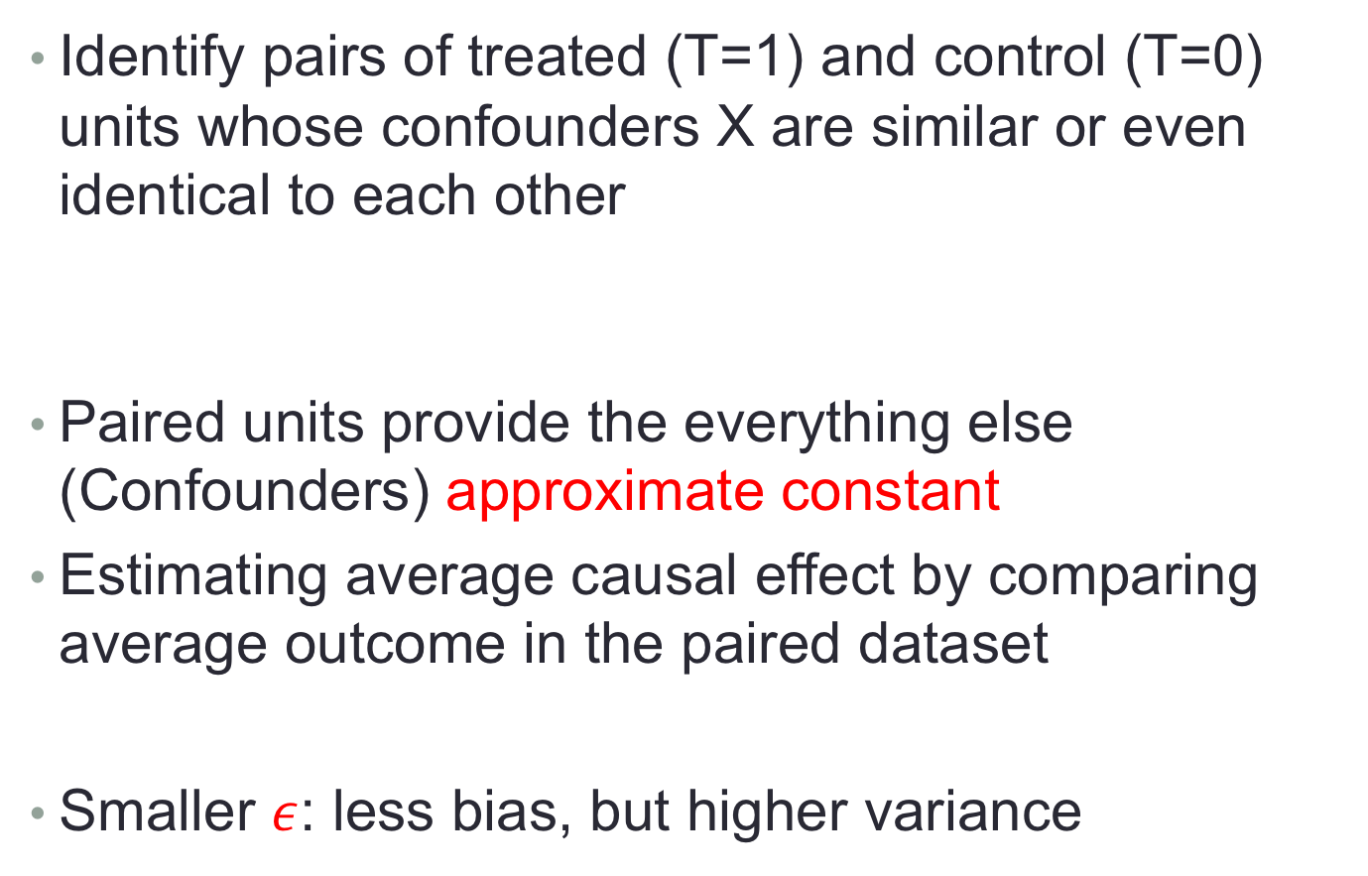


Matching
Identify pairs of treated (T=1) and control (T=0) units whose confounders X are similar or even identical to each other
Paired units provide the everything else (Confounders) approximate constant
Estimating average causal effect by comparing average outcome in the paired dataset
Smaller $ε$: less bias, but higher variance
$$Distance\left(X_{i}, X_{j}\right)≤ε$$
$$i$$
$$j$$
Notes:
In above matching process, a distance measurement is needed to describe the similarity between units, if their distance is less than epsilon, then we think they are similar and can be matched, otherwise, not.
Then, we can identify …
A small threshold epsilon can provide that the everything else between treated and control groups are approximate constant. Hence, we can estimate the average causal effect by comparing their outcome in the paired dataset.
Need to note that
In the distance measurement, the threshold \epsilon will affect the bias and variance of estimated causal effect. Smaller \epsilon help to balance confounder better, reducing the bias of causal effect estimation, but will decrease the number of treated and control pairs, leading to high variance of causal effect estimation.
So we need to carefully set epsilon when using matching methods.

Slide 33
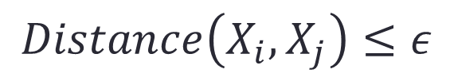
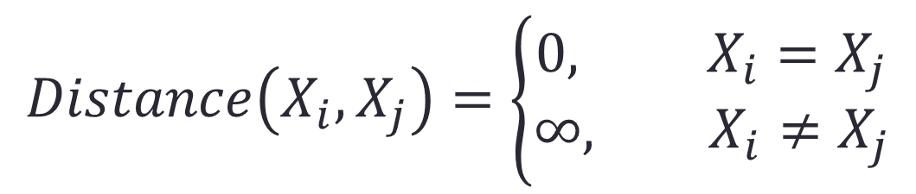
Matching
Exactly Matching:
Easy to implement, but limited to low-dimensional settings
Since in high-dimensional settings, there will be few exact matches
$$Distance\left(X_{i},X_{j}\right)=\left\{\begin{aligned}0, X_{i}=X_{j} \\ &∞, X_{i}≠X_{j}\end{aligned}\right.$$
$$i$$
$$j$$
$$Distance\left(X_{i}, X_{j}\right)≤ε$$
Notes:
If we set the distance measurement as follows. That is only two units with exactly the same features can be matched. This is exactly matching method.
Matching methods are easily implemented in real applications, but they are limited to low-dimensional settings. Since in high dimensional settings, we can hardly to find exact matches.

Slide 34
Methods for Causal Inference
Matching
Propensity Score Based Methods
Propensity Score Matching
Inverse of Propensity Weighting (IPW)
Doubly Robust
Data-Driven Variable Decomposition (D²VD)
Directly Confounder Balancing
Entropy Balancing
Approximate Residual Balancing
Differentiated Confounder Balancing
Notes:
To address the high dimensional challenges, we will introduce propensity score based methods, including …

Slide 35
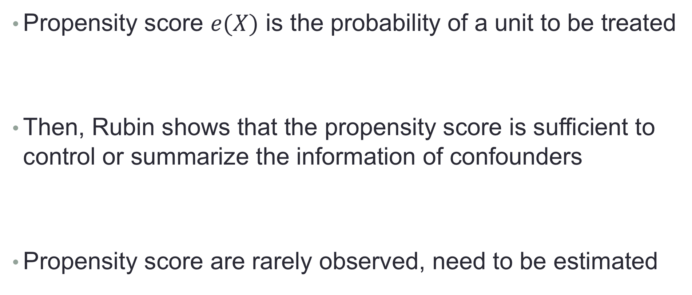
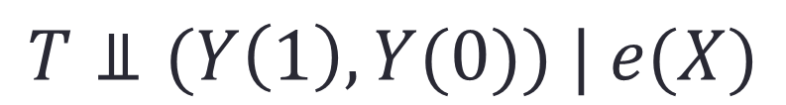
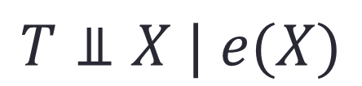
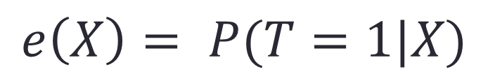
Propensity Score Based Methods
Propensity score $e(X)$ is the probability of a unit to be treated
Then, Rubin shows that the propensity score is sufficient to control or summarize the information of confounders
Propensity score are rarely observed, need to be estimated
$$e\left(X\right)= P(T=1|X)$$
$$T⫫X | e(X)$$
$$T⫫(Y\left(1\right),Y(0)) | e(X)$$
Notes:
First, the propensity score is defined as the propensity or probability of a unit to be treated. For example, the probability of taking the medication for a patient.
Then, Rubin … That is given propensity score, the treatment will become independently with confounder. With this result, one can easily prove that given the propensity score, the unconfounderness assumption is satisfied.
In real applications, however, we can hardly know the true propensity score, so need to estimate it.

Slide 36
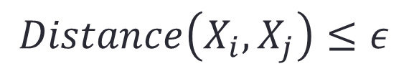
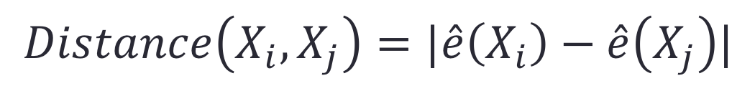
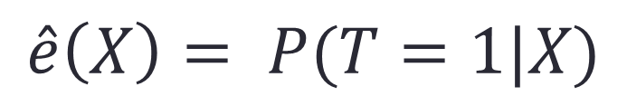
Propensity Score Matching
$$\hat{e}\left(X\right)= P(T=1|X)$$
Estimating propensity score:
Supervised learning: predicting a known label T based on observed covariates X.
Conventionally, use logistic regression
Matching pairs by distance between propensity score:
High dimensional challenge:
$$Distance\left(X_{i}, X_{j}\right)≤ε$$
$$Distance\left(X_{i}, X_{j}\right)=|\hat{e}\left(X_{i}\right)−\hat{e}\left(X_{j}\right)|$$
transferred from matching to PS estimation
Notes:
Estimating propensity score can be regarded as a supervised learning problem, you know, a classic binary classification problem, estimating the label of treatment T based on the observed variables X.
Logistical regression is the conventional method to estimate propensity score, other machine learning methods can also be applied to estimate propensity score.
Based on propensity score, we can define a distance measurement to match treated and control units pair. This is Propensity score matching method.
In previous matching method, the main challenge is from high dimensional variables when matching. In PSM, high dimensional challenge is transferred form matching step to propensity score estimation step. And propensity score estimation is a supervised learning methods, many regularizer can be applied to address the high dimensional problem, for example LASSO.

Slide 37
Methods for Causal Inference
Matching
Propensity Score Based Methods
Propensity Score Matching
Inverse of Propensity Weighting (IPW)
Doubly Robust
Data-Driven Variable Decomposition (D²VD)
Directly Confounder Balancing
Entropy Balancing
Approximate Residual Balancing
Differentiated Confounder Balancing

Slide 38
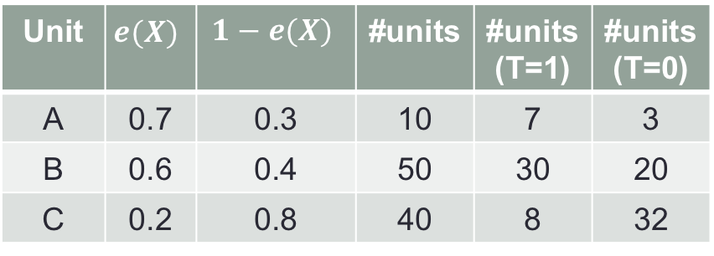
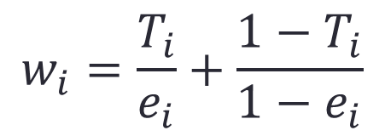
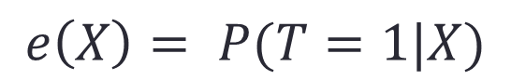
Inverse of Propensity Weighting (IPW)
Why weighting with inverse of propensity score is helpful?
Propensity score induces the distribution bias on confounders X
$$e\left(X\right)= P(T=1|X)$$
Unit | $$e(X)$$ | $$1−e(X)$$ | #units | #units(T=1) | #units(T=0)
A | 0.7 | 0.3 | 10 | 7 | 3
B | 0.6 | 0.4 | 50 | 30 | 20
C | 0.2 | 0.8 | 40 | 8 | 32
Unit | #units(T=1) | #units(T=0)
A
B
C
10
10
Confounders are the same!
50
50
40
40
Distribution Bias
$$w_{i}=\frac{T_{i}}{e_{i}}+\frac{1−T_{i}}{1−e_{i}}$$
Reweighting by inverse of propensity score:
Notes:
Next, we will introduce a widely used propensity score based method, the Inverse of Propensity Weighting method.
IPW was proposed to reweight samples by their inverse of propensity score for confounder balancing.
We will give a toy example to explain why weighting is helpful.
In our example, we have three kinds of units, U1, U2 and U3, and different units with different propensity score to be treated. For example, the Unit U1, its propensity score is 0.7, if we observed 10 units 1 in our data, there would be 7 treated U1 and 3 control U1 ideally. Similarity, for unit U2, there would be 30 treated and 20 control, and for U3, 8 treated and 32 control.
Finally, we will found that the distribution of confounders X will be different between the treated group and control groups, where we observed 7 U1, 30 U2, and 8 U3 in treated group, while we observed 3 U1, 20 U2 and 32 U3 in control group. And this distribution bias is induced by the propensity score.
If we know the exactly propensity score of each unit, we can reweight them by the inverse of propensity score, specifically, for a treated unit T=1, we reweight it by the inverse of propensity score, for a control unit, we reweight it by the inverse of 1 minus propensity score. For example, for the treated U1, we weight them by 1 over 0.7, we can obtain 10 treated U1, and for the control U1, we reweight them by 1 over 0.3, we also can get 10 control U1, similarity for U2 and U3. Finally, we would find that the number of each kind of Units are the same between treated and control groups after reweighting.
That is by sample reweighting with the inverse of propensity score, we can make the confounders between treated and control groups become the same.

Slide 39
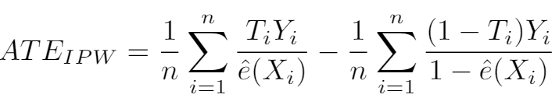
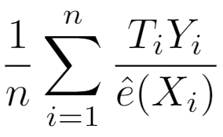
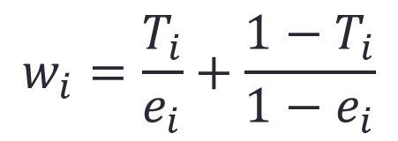
Inverse of Propensity Weighting (IPW)
$$w_{i}=\frac{T_{i}}{e_{i}}+\frac{1−T_{i}}{1−e_{i}}$$
Estimating ATE by IPW [1]:
Interpretation: IPW creates a pseudo-population where the confounders are the same between treated and control groups.
Why does this work? Consider
Notes:
Then, we can estimate the average treatment effect by inverse of propensity weighting as follows. After sample reweighting, the average treatment effect can be estimated by using the weighted mean value of outcome on treated groups to minus that one on control group, where the e hat represents the estimated propensity score, since we can hardly know the exactly propensity score in many real applications.
The interpretation of IPW estimation is that, the inverse of propensity weighting creates …
In previous toy example we demonstrate why inverse propensity score works, next we will prove that with theoretical analysis. Let’s firstly consider the treated component.
\begin{eqnarray}ATE = \frac{1}{n}\sum_{i=1}^{n}\frac{T_iY_i}{\hat{e}(X_i)} - \frac{1}{n}\sum_{i=1}^{n}\frac{(1-T_i)Y_i}{1-\hat{e}(X_i)}\end{eqnarray}

Slide 40
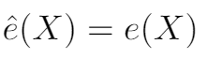
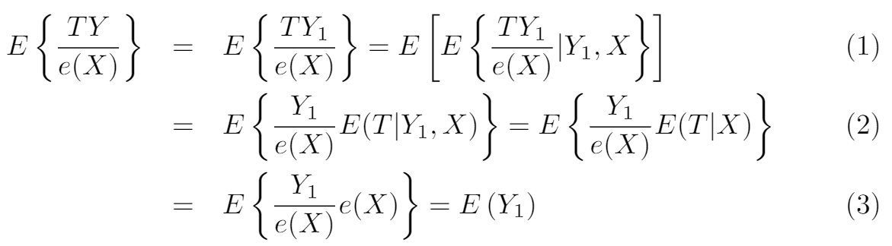
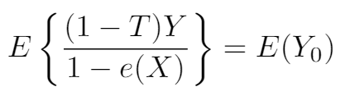
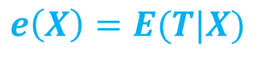
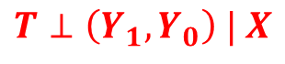
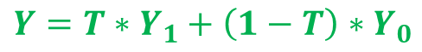

Inverse of Propensity Weighting (IPW)
If: , the true propensity score
Similarly:
$$Y=T∗Y_{1}+\left(1−T\right)∗Y_{0}$$
$$T⊥\left(Y_{1},Y_{0}\right) | X$$
$$e\left(X\right)=E(T|X)$$
$$ATE=E[Y\left(1\right)−Y\left(0\right)]$$
Notes:
By assuming that the estimated propensity score e hat is exactly the true propensity score, then we have following results:
First, from the equation of Y, we have that the expectation of TY over e(X) equals to the expectation of TY1 over e(X)
Then, with the unconfounderness assumption, that given X, T is independent with Y1 and Y0, we have that the expectation of T given Y1 and X equals to the expectation of T given X.
Finally, by the definition of propensity score e(X), we know the expectation of T given X is the propensity score.
Hence, we can prove that the expectation of TY over e(X) is exactly the expectation of potential outcome Y1.
Similarity, we can also prove that the expectation of (1-T)Y over (1-e(X)) equals to the expectation of potential outcome Y0.
Recall that the average treatment effect is defined as the expectation of difference between potential outcome Y1 and Y0, we know that
TY = T{T*Y_1+(1-T)*Y_0} = T^2 * Y_1 + T(1-T)Y_0 (T is binary)
Ignorability: (Y_1, Y_0) _||_ T | X
e(X) = E(T|X)
\begin{eqnarray} E\left\{\frac{T Y}{e({X})}\right\} &=& E\left\{\frac{T Y_{1}}{e({X})}\right\}=E\left[E\left\{\frac{T Y_{1}}{e({X})} | Y_{1}, {X}\right\}\right] \\&=&E\left\{\frac{Y_{1}}{e({X})} E(T | Y_{1}, {X})\right\}=E\left\{\frac{Y_{1}}{e({X})} E(T | {X})\right\} \\&=&E\left\{\frac{Y_{1}}{e({X})} e({X})\right\}=E\left(Y_{1}\right) \end{eqnarray}

Slide 41


Inverse of Propensity Weighting (IPW)
If: , the true propensity score, the IPW estimator is unbiased
Wildly used in many applications
But requires the propensity score model is correct
High variance when $e$ is close to 0 or 1
Notes:
If the estimated propensity score the exactly the true propensity score, then the IPW estimator is unbiased for treatment effect estimation.
The IPW estimator is widely used and achieved good performance in many real applications.
But is there any disadvantage or drawback for IPW estimator?
One is that IPW need the estimated propensity score is exactly the true propensity score, so it requires the propensity score model is correct.
Second is that when estimated propensity score is close to 0 and 1, the weight would be huge, leading to high variance of treatment effect estimation.

Slide 42
Methods for Causal Inference
Matching
Propensity Score Based Methods
Propensity Score Matching
Inverse of Propensity Weighting (IPW)
Doubly Robust
Data-Driven Variable Decomposition (D²VD)
Directly Confounder Balancing
Entropy Balancing
Approximate Residual Balancing
Differentiated Confounder Balancing

Slide 43


Doubly Robust
Recap:
Simple outcome regression:
Unbiased if the regression models are correct
IPW estimator:
Unbiased if the propensity score model is correct
Doubly Robust [2]: combine both approaches
$$ATE=E[Y\left(T=1\right)−Y\left(T=0\right)]$$
and
Notes:
Next, we will introduce another method based on propensity score, doubly robust method
From the definition of ATE, we know that one can estimate ATE if he knows the potential outcome Y1 and Y0 for each units.
But in observational data, we know only one potential outcome of each unit. A simple way to address this problem is to predict the unobserved potential outcome.
In simple outcome regression, we learn regression model for treated group and control group, respectively.
The simple outcome regression method is unbiased if the regression models are correct.
Recap that IPW method we introduced before also need the correct model specification to guarantee the unbiasedness.
Then, the doubly robust method was proposed by combining both outcome regression and IPW method in a fortuitous way.

Slide 44

Doubly Robust
Estimating ATE with Doubly Robust estimator:
Unbiased if either propensity score or regression model is correct
This property is referred to as double robustness
Notes:
By combining regression and IPW method, the doubly robust estimator can be represented as following, where e hat is estimated propensity score, and m1 m0 are outcome regression models.
Either propensity score model or outcome regression model is correct, the doubly robust estimator is unbiased to estimate average causal effect.
This property is referred to as double robustness.
\begin{eqnarray}ATE_{DR}&=& \frac{1}{n} \sum_{i=1}^{n}\left[\frac{T_{i} Y_{i}}{\hat{e}(X_i)}-\frac{\left\{T_{i}-\hat{e}(X_i)\right\}}{\hat{e}(X_i)} \hat{m}_1(X_i)\right] \\ &\_& - \frac{1}{n} \sum_{i=1}^{n}\left[\frac{\left(1-T_{i}\right) Y_{i}}{1-\hat{e}(X_i)}+\frac{\left\{T_{i}-\hat{e}(X_i)\right\}}{1-\hat{e}(X_i)} \hat{m}_{0}(X_i)\right] \end{eqnarray}

Slide 45

Doubly Robust
Theoretical Proof:
Notes:
Here, we give the proof of unbiasedness of doubly robust method. We firstly proved the treated part equals to the expectation of Y1, since the term in the red rectangle would equal 0 if either e hat equals to true propensity score, or the m1 equals to Y1.
Similarity, we can prove the control part in doubly robust estimator equals the expectation of Y0.

Slide 46
Doubly Robust
Estimating ATE with Doubly Robust estimator:
Unbiased if propensity score or regression model is correct
This property is referred to as double robustness
But may be very biased if both models are incorrect
Notes:
But if both models are incorrect, doubly robust method would be very biased.
\begin{eqnarray}ATE_{DR}&=& \frac{1}{n} \sum_{i=1}^{n}\left[\frac{T_{i} Y_{i}}{\hat{e}(X_i)}-\frac{\left\{T_{i}-\hat{e}(X_i)\right\}}{\hat{e}(X_i)} \hat{m}_1(X_i)\right] \\ &\_& - \frac{1}{n} \sum_{i=1}^{n}\left[\frac{\left(1-T_{i}\right) Y_{i}}{1-\hat{e}(X_i)}+\frac{\left\{T_{i}-\hat{e}(X_i)\right\}}{1-\hat{e}(X_i)} \hat{m}_{0}(X_i)\right] \end{eqnarray}

Slide 47

Propensity Score based Methods
Recap:
Propensity Score Matching
Inverse of Propensity Weighting
Doubly Robust
Need to estimate propensity score
Treat all observed variables as confounders
In Big Data Era, High dimensional data
But, not all variables are confounders
Notes:
We have introduced three kinds of propensity score based methods, including …
In PSM, we match treated and control pairs by their propensity score. In IPW, we reweight samples by their inverse of propensity score. Doubly robust method combined both IPW estimator and outcome regression method.
All of these propensity score based method need to estimate propensity score, and their performance depends on the accuracy of estimated propensity score.
However, all of these methods treat all observed variables as confounder when estimating propensity score.
In practical, especially in big data era, we always observed hundred and thousand variables, but not all of those variables are confounders, only that related to treatment variables and outcome variable are confounders, and some non-confounders are helpful on treatment effect estimation.
Hence, to precisely estimate the average causal effect in high dimensional setting, we need to separate the confounders.
But the question is how to automatically separate the confounders from all observed variables.

Slide 48
Propensity Score based Methods
Recap:
Propensity Score Matching
Inverse of Propensity Weighting
Doubly Robust
Need to estimate propensity score
Treat all observed variables as confounders
In Big Data Era, High dimensional data
But, not all variables are confounders
How to automatically separate the confounders?
Notes:
We have introduced three kinds of propensity score based methods, including …
In PSM, we match treated and control pairs by their propensity score. In IPW, we reweight samples by their inverse of propensity score. Doubly robust method combined both IPW estimator and outcome regression method.
All of these propensity score based method need to estimate propensity score, and their performance depends on the accuracy of estimated propensity score.
However, all of these methods treat all observed variables as confounder when estimating propensity score.
In practical, especially in big data era, we always observed hundred and thousand variables, but not all of those variables are confounders, only that related to treatment variables and outcome variable are confounders, and some non-confounders are helpful on treatment effect estimation.
Hence, to precisely estimate the average causal effect in high dimensional setting, we need to separate the confounders.
But the question is how to automatically separate the confounders from all observed variables.

Slide 49
Methods for Causal Inference
Matching
Propensity Score Based Methods
Propensity Score Matching
Inverse of Propensity Weighting (IPW)
Doubly Robust
Data-Driven Variable Decomposition (D²VD)
Directly Confounder Balancing
Entropy Balancing
Approximate Residual Balancing
Differentiated Confounder Balancing (DCB)

Slide 50



Inverse of Propensity Weighting (IPW)
Treat all observed variables U as confounders X
Propensity Score Estimation:
Adjusted Outcome:
IPW ATE Estimator:
Notes:
In traditional IPW estimator, all observed variables are regarded as confounder X, and estimate the propensity score with U. With the estimated propensity score, IPW estimate reweights sample and their outcome by the inverse of propensity score, and finally estimate the average causal effect by the expectation of the adjusted outcome.

Slide 51



Data-Driven Variable Decomposition (D²VD)
Separateness Assumption:
All observed variables U can be decomposed into three sets: Confounders X, Adjustment Variables Z, and Irrelevant variables I (Omitted).
Propensity Score Estimation:
Adjusted Outcome:
Our D²VD ATE Estimator:
Notes:
Comparing with previous causal framework, we propose a new causal framework.
In our causal framework, we assume all the observed variables U can be decomposed into three sets:
(1) Confounders X, which are associated with the treatment T and may be causally related to the outcome Y.
(2) Adjustment Variables Z, which are causally related to outcome Y , but independent with treatment T.
and (3) Irrelevant variables I, which are independent with both treatment and outcome and omitted in our causal framework.
With the separated confounder X, we can precisely estimate the propensity score, and with the separated adjustment variables Z, we can regressing Y on them to reduce the variance of Y.
Finally, based on our adjusted outcome, we can estimate the average treatment effect by the expectation of adjusted outcome.

Slide 52




Data-Driven Variable Decomposition (D²VD)
Confounders Separation & ATE Estimation.
With our D²VD estimator:
By minimizing following objective function:
We can estimate the ATE as:
Notes:
Based on our causal framework, we proposed an data driven variables decomposition algorithm to jointly optimize confounders separation and ATE estimation.
skip
With our adjusted estimator, we can estimate the ATE by the expectation of adjusted outcome Y plus.
If we assume the treatment effect is heterogeneous and represented by function h(U), we can obtain the estimated ATE by regression out adjusted outcome Y plus against the variables U and minimizing following objective function.
Then, we can estimate the ATE by the expectation of function h(U).

Slide 53






Data-Driven Variable Decomposition (D²VD)
Where
Replace X, Z with U
Where
Adjustment variables:
Confounders:
Treatment Effect:
$$α, β, γ$$
Notes:
Here is the details of our algorithm, where we adopt logistic regression to evaluate the propensity score with coefficient vector \beta, and adopt a linear regression to adjust outcome with coefficient vector \alpha.
Then, we employ an orthogonal regularizer on \alpha and \beta for ensuring the separation of confounders and adjustment variables.
Finally, with the optimized parameters, we can separate the adjustment variables by parameter \alpha, separate the confounders by parameter \beta, and estimate the ATE by parameter \gamma.

Slide 54


Data-Driven Variable Decomposition (D²VD)
Bias Analysis:
Our D²VD algorithm is unbiased to estimate causal effect
Variance Analysis:
The asymptotic variance of Our D²VD algorithm is smaller
Notes:
Theoretically, we did both bias and variance analysis for our DVD estimator, we proved that …

Slide 55
Data-Driven Variable Decomposition (D²VD)
OUR: Data-Driven Variable Decomposition (D²VD)
Baselines
Directly Estimator (dir): ignores confounding bias
IPW Estimator (IPW): treats all variables as confounders
Doubly Robust Estimator (DR): IPW+regression
Non-Separation Estimator (D²VD-): no variables separation
Notes:
In our experiments, we compared our algorithm with following baselines, including …, where Non-separation estimator is a weak version of our algorithm, which has no variables separation.

Slide 56


Data-Driven Variable Decomposition (D²VD)
Dataset generation:
Sample size m={1000,5000}
Dimension of observed variables n={50,100,200}
Observed variables:
Treatment: logistic and misspecified
Outcome:
Notes:
First, we show the experiments on synthetic data.
We generate the observed variables U with independent Gaussian distribution.
To test the robustness of our estimator, we generate the binary treatment variable T from a logistic function and misspecified function.
The outcome Y is generated with linear regression on treatment T, confounders X and adjustment variables Z.
In the synthetic data, we know the true treatment effect is 1.

Slide 57
Data-Driven Variable Decomposition (D²VD)
Dataset generation:
Sample size m={1000,5000}
Dimension of observed variables n={50,100,200}
Observed variables:
Treatment: logistic and misspecified
Outcome:
The true treatment effect in synthetic data is 1.
Notes:
First, we show the experiments on synthetic data.
We generate the observed variables U with independent Gaussian distribution.
To test the robustness of our estimator, we generate the binary treatment variable T from a logistic function and misspecified function.
The outcome Y is generated with linear regression on treatment T, confounders X and adjustment variables Z.
In the synthetic data, we know the true treatment effect is 1.

Slide 58


Data-Driven Variable Decomposition (D²VD)
Experimental Results on Synthetic Data:
Notes:
Here, we show the results of ATE estimation on synthetic dataset. The bias refers to the absolute error between the true and estimated ATE. The smaller bias, SD, MAE and RMSE, the better. From the results, we have following observations.
1, The direct estimator is failed under different setting because it did not consider the confounding bias.
2, The IPW and DR estimators is good when treatment T from logistic function, but poor when treatment from a misspecied function.
3, The DVD(-) estimator, which has no variables separation, get similar results with DR estimator.
4, With considering the variables decomposition, our DVD algorithm can improve accuracy and reduce variance for ATE estimation.

Slide 59
Data-Driven Variable Decomposition (D²VD)
The direct estimator is failed under all settings.
IPW and DR estimators are good when T=T_{logit}, but poor when T=T_{missp}.
D²VD(-) has no variables separation, get similar results with DR estimator.
D²VD can improve accuracy and reduce variance for ATE estimation.
Experimental Results on Synthetic Data:
Notes:
Here, we show the results of ATE estimation on synthetic dataset. The bias refers to the absolute error between the true and estimated ATE. The smaller bias, SD, MAE and RMSE, the better. From the results, we have following observations.
1, The direct estimator is failed under different setting because it did not consider the confounding bias.
2, The IPW and DR estimators is good when treatment T from logistic function, but poor when treatment from a misspecied function.
3, The DVD(-) estimator, which has no variables separation, get similar results with DR estimator.
4, With considering the variables decomposition, our DVD algorithm can improve accuracy and reduce variance for ATE estimation.

Slide 60

Data-Driven Variable Decomposition (D²VD)
Experimental Results on Synthetic Data:
TPR: true positive rate
TNR: true negative rate
Our D²VD algorithm can precisely separate the confounders and adjustment variables.
Notes:
Here, we show the results of variables decomposition on synthetic data, where the TPR means true positive rate and TNR means true negative rate. The closer to 1 of TPR and TNR, the better.
The results demonstrate that our D²VD algorithm can precisely separate the confounders and adjustment variables.

Slide 61

Experiments on Real World Data
Dataset Description:
Online advertising campaign (LONGCHAMP)
Users Feedback: 14,891 LIKE; 93,108 DISLIKE
56 Features for each user
Age, gender, #friends, device, user setting on WeChat
Experimental Setting:
Outcome Y: users feedback
Treatment T: one feature
Observed Variables U: other features
2015
Y = 1, if LIKE
Y = 0, if DISLIKE
Notes:
We also apply our algorithm on real online advertising dataset. The data is about LONGCHAMP handbags campaign, collected from Tencent WeChat App. This campaign contains over 100,000 users feedback with LIKE and DISLIKE. And for each user, we have 56 features. In our experiments, we set the feedback of users about the ad as outcome, alternative set one user feature as treatment T and set other features as observed variables U. So, we can evaluate the causal effect of each user feature.

Slide 62

Experiments Results
ATE Estimation.
1. Our D²VD estimator evaluate the ATE more accuracy.
2. Our D²VD estimator can reduce the variance of estimated ATE.
3. Younger Ladies are with higher probability to like the LONGCHAMP ads.
Notes:
Here, we show the results of ATE estimation. From the results, we have following observations.
1. Our D²VD estimator evaluate the ATE more accuracy.
2. Our D²VD estimator can reduce the variance of estimated ATE.
3. The ATE of age bigger than 33 and male gender are negative, which indicate that the younger ladies are with higher probability to like the LONGCHAMP ads.

Slide 63

Experiments Results
Variables Decomposition.
1. The confounders are many other ways for adding friends on WeChat.
2. The adjustment variables have significant effect on outcome.
3. Our D²VD algorithm can precisely separate the confounders and adjustment variables.
Notes:
Here we show the variables decomposition results when we set feature “Add friend by Shake” as treatment. In the results, the separated confounders are many other ways for adding friends on WeChat, and the separated adjustment variables have significant effect on outcome. The results demonstrate that our DVD algorithm can precisely separate the confounders and adjustment variables.

Slide 64

Summary: Propensity Score based Methods
$$e\left(X\right)= P(T=1|X)$$
Propensity Score Matching (PSM):
Units matching by their propensity score
Inverse of Propensity Weighting (IPW):
Units reweighted by inverse of propensity score
Doubly Robust (DR):
Combing IPW and regression
Data-Driven Variable Decomposition (D²VD):
Automatically separate the confounders and adjustment variables
Confounder: estimate propensity score for IPW
Adjustment variables: regression on outcome for reducing variance
Improving accuracy and reducing variance on treatment effect estimation
But, these methods need propensity score model is correct
Treat all observed variables as confounder, ignoring non-confounders
Notes:
Here, we give a summary on propensity score based methods for treatment effect estimation.
The propensity score is defined as the probability of getting treated for each unit.
Based on propensity score, propensity score matching method match units that are with similar propensity score but different treatment status to guarantee the confounders’ distribution are similar between the treated and control group.
In IPW method, the confounders can be balanced by sample reweighting with their inverse of propensity score.
DR combined IPW and regression model, achieved double robustness.
Traditional propensity score based methods treated all observed variables as confounder when estimating propensity score, leading to bad performance in high dimensional setting.
In practical, not all observed variables are confounders. Hence, the data-driven variable decomposition algorithm proposed to automatically separate the confounders and adjustment variables, where the confounder … and the adjustment variables can be used to regress on outcome for reduce variance.
Overall, propensity score based method need to estimate the propensity score, hence requiring the assumed propensity score model is correct.

Slide 65
Methods for Causal Inference
Matching
Propensity Score Based Methods
Propensity Score Matching
Inverse of Propensity Weighting (IPW)
Doubly Robust
Data-Driven Variable Decomposition (D²VD)
Directly Confounder Balancing
Entropy Balancing
Approximate Residual Balancing
Differentiated Confounder Balancing (DCB)
Notes:
To avoid model misspecification on propensity score model, some researchers proposed directly confounder balancing methods for treatment effect estimation, bypassing propensity score estimation.

Slide 66
Causal Inference with Observational Data
Average Treatment Effect (ATE):
Average Treatment effect on the Treated (ATT):
Two key points:
Changing T (T=1 and T=0)
Keeping everything else (Confounder X) constant
$$ATE=E[Y\left(T=1\right)−Y\left(T=0\right)]$$
$$ATT=E[Y\left(1\right)|T=1]−E[Y\left(0\right)|T=1]$$
Notes:
Based on the definition of ATE, we give the definition of ATT, the average treatment effect on the treated.
Recall that the two key points for estimating causal effect are …
In our observational data, we observed treated units and control units, but the confounder X between treated and control group might be different. Hence, to precisely estimate ATT and ATE, we need to balance confounders between treated and control units.

Slide 67
Causal Inference with Observational Data
Average Treatment Effect (ATE):
Average Treatment effect on the Treated (ATT):
Two key points:
Changing T (T=1 and T=0)
Keeping everything else (Confounder X) constant
$$ATE=E[Y\left(T=1\right)−Y\left(T=0\right)]$$
$$ATT=E[Y\left(1\right)|T=1]−E[Y\left(0\right)|T=1]$$
Balancing Confounders’ Distribution
Notes:
Based on the definition of ATE, we give the definition of ATT, the average treatment effect on the treated.
Recall that the two key points for estimating causal effect are …
In our observational data, we observed treated units and control units, but the confounder X between treated and control group might be different. Hence, to precisely estimate ATT and ATE, we need to balance confounders between treated and control units.

Slide 68

Directly Confounder Balancing
Recap: Propensity score based methods
Sample reweighting for confounder balancing
But, need propensity score model is correct
Weights would be very large if propensity score is close to 0 or 1
Can we directly learn sample weight that can balance confounders’ distribution between treated and control?
$$w_{i}=\frac{T_{i}}{e_{i}}+\frac{1−T_{i}}{1−e_{i}}$$
Yes!
Notes:
As we introduced before, propensity score can be implied for confounder balancing by sample reweighting.
But those methods need propensity score model is correct, and the inverse of propensity weight would be very large if the estimated propensity score is close to 0 or 1, leading to high variance of estimated causal effect.
So, some researchers thought that why we need propensity score, can we just bypass propensity score estimation, and directly learn a sample weight that can …
The answer is YES.

Slide 69

Directly Confounder Balancing
Motivation: The collection of all the moments of variables uniquely determine their distributions.
Methods: Learning sample weights by directly balancing confounders’ moments as follows
The first moments of X on the Treated Group
The first moments of X on the Control Group
With moments, the sample weights can be learned without any model specification.
Notes:
The motivation of directly confounder balancing is that …
Hence, in order to balancing confounders’ distribution, some methods were proposed to learn sample weight by directly balancing confounders’ moments as follows, where X_T bar means the first moments of confounder X on the treated group, and X_c transpose W refers to the first moment of X on the control group with sample weight W.
By minimizing the difference of moments between treated and control groups, we can learn a sample weight that achieves the confounder balancing.
With the learned sample weights W, one can estimate the ATT by comparing weighted outcome between treated and control groups.

Slide 70

Directly Confounder Balancing
Motivation: The collection of all the moments of variables uniquely determine their distributions.
Methods: Learning sample weights by directly balancing confounders’ moments as follows
Estimating ATT by:
The first moments of X on the Treated Group
The first moments of X on the Control Group
Notes:
The motivation of directly confounder balancing is that …
Hence, in order to balancing confounders’ distribution, some methods were proposed to learn sample weight by directly balancing confounders’ moments as follows, where X_T bar means the first moments of confounder X on the treated group, and X_c transpose W refers to the first moment of X on the control group with sample weight W.
By minimizing the difference of moments between treated and control groups, we can learn a sample weight that achieves the confounder balancing.
With the learned sample weights W, one can estimate the ATT by comparing weighted outcome between treated and control groups.

Slide 71
Methods for Causal Inference
Matching
Propensity Score Based Methods
Propensity Score Matching
Inverse of Propensity Weighting (IPW)
Doubly Robust
Data-Driven Variable Decomposition (D²VD)
Directly Confounder Balancing
Entropy Balancing
Approximate Residual Balancing
Differentiated Confounder Balancing (DCB)

Slide 72

Entropy Balancing
Directly confounder balancing by sample weights W
Maximize the entropy of sample weights W
But, treat all variables as confounders and balance them equally
Notes:
Here, we show the objective function of Entropy Balancing method, where they balance confounders based on their first moment by learning sample weights W, they also maximize the entropy of sample weights.
But, from their confounder balancing term, we know that they treat all observed variables as confounders and balance them equally.

Slide 73




Approximate Residual Balancing
1. compute approximate balancing weights W as
2. Fit $β_{c}$ in the linear model using a lasso or elastic net,
3. Estimate the ATT as
Double Robustness: Exact confounder balancing or regression is correct.
But, treats all variables as confounders and balance them equally
Notes:
As for approximate residual balancing method, there are three main steps. In the first step, they also directly balance confounders based on the first moment by learning sample weights W, and minimize the variance of sample weights W with a L2 norm.
In the second step, they apply a regression model to learn the potential outcome Y0, and utilize the LASSO or elastic net regularizer to address the high dimensional challenge.
Finally, based on the sample weights learned in step 1 and regression model in step 2, they estimate the ATT with residual of outcome.
Theoretically, we can prove that the approximate residual balancing method is double robustness if the sample weight W can exactly balance confounders or the regression model is correct.
But approximate residual balancing method also treats all variables as confounders and balance them equally.
$$
\widehat{ATT} = \sum_{i:T_i=1}\frac{1}{n_t}Y(1) - \sum_{j:T_j = 0}W_jY(0)
$$
\begin{equation}
\nonumber W=\operatorname{argmin}_{W}\left\{(1-\zeta)\|W\|_{2}^{2}+\zeta\left\|\overline{X}_{\mathrm{t}}-\mathbf{X}_{\mathrm{c}}^{\top} W\right\|_{\infty}^{2} \text { s.t. } \sum_{\left\{i : T_{i}=0\right\}} W_{i}=1 \text{ and } W_{i} \geq 0\right\}
\end{equation}
\begin{equation}
\nonumber \hat{\beta}_{\mathrm{c}}=\operatorname{argmin}_{\beta}\left\{\sum_{\left\{i : W_{i}=0\right\}}\left(Y_{i}^{\mathrm{obs}}-X_{i} \cdot \beta\right)^{2}+\lambda\left((1-\alpha)\|\beta\|_{2}^{2}+\alpha\|\beta\|_{1}\right)\right\}
\end{equation}
\begin{equation}
\nonumber \widehat{ATT}=\overline{Y}_{t}-\left(\overline{X}_{t} \cdot \hat{\beta}_{c}+\sum_{\left\{i : T_{i}=0\right\}} W_{i}\left(Y_{i}^{\mathrm{obs}}-X_{i} \cdot \hat{\beta}_{\mathrm{c}}\right)\right)
\end{equation}

Slide 74
Directly Confounder Balancing
Recap:
Entropy Balancing, Approximate Residual Balancing etc.
Moments uniquely determine variables’ distribution
Learning sample weights by balancing confounders’ moments
But, treat all variables as confounders, and balance them equally
Different confounders make different confounding bias
The first moments of X on the Treated Group
The first moments of X on the Control Group
Notes:
We have introduced two main methods for directly confounder balancing, including entropy balancing and approximate residual balancing. Their motivation is that moments uniquely determine the variables’ distribution, hence the confounder can be balanced by learning sample weight to minimize the distance of moments between treated and control groups.
But these method treat all variables as confounders and balance them equally. While, in real application, not all observed variables are confounders and different confounders make different confounding bias.
How to differentiated confounders and their bias is still a problem.

Slide 75
Directly Confounder Balancing
Recap:
Entropy Balancing, Approximate Residual Balancing etc.
Moments uniquely determine variables’ distribution
Learning sample weights by balancing confounders’ moments
But, treat all variables as confounders, and balance them equally
Different confounders make different confounding bias
How to differentiated confounders and their bias?
The first moments of X on the Treated Group
The first moments of X on the Control Group
Notes:
We have introduced two main methods for directly confounder balancing, including entropy balancing and approximate residual balancing. Their motivation is that moments uniquely determine the variables’ distribution, hence the confounder can be balanced by learning sample weight to minimize the distance of moments between treated and control groups.
But these method treat all variables as confounders and balance them equally. While, in real application, not all observed variables are confounders and different confounder make different confounding bias.
How to differentiated confounders and their bias is still a problem.

Slide 76
Methods for Causal Inference
Matching
Propensity Score Based Methods
Propensity Score Matching
Inverse of Propensity Weighting (IPW)
Doubly Robust
Data-Driven Variable Decomposition (D²VD)
Directly Confounder Balancing
Entropy Balancing
Approximate Residual Balancing
Differentiated Confounder Balancing (DCB)
Notes:
To address this problem, we propose a differentiated confounder balancing algorithm

Slide 77


Differentiated Confounder Balancing
Ideas: simultaneously learn confounder weights $β$ and sample weighs $W$.
Confounder weights determine which variable is confounder and its contribution on confounding bias.
Sample weights are designed for confounder balancing.
How to learn the confounder weights?
Notes:
In our differentiated confounder balancing algorithm we propose to simultaneously learn confounder weights beta and sample weights W, where the confounder weight determine which variable is confounder and its contribution on confounding bias, the sample weights W are designed for confounder balancing.
But how to learn these weights?

Slide 78






Confounder Weights Learning
General relationship among$X$, $T$, and $Y$:
Confounder weights
Confounding bias
If $α_{k}=0$, then $M_{k}$ is not confounder, no need to balance.
Different confounders have different confounding weights.
Notes:
First, confounder weights learning. In the causal framework, the general relationship among X, T, and Y can be represented as following, where we can obtain the real treatment effect ATT. With general function f(X), we find that there is a bias term between the real and estimated ATT on theory.
And the bias term can be decomposed as confounding bias of each augmented variable M_k, and a corresponding confounder weights alpha_k. From the theoretical analysis, we know that…
We also find that the confounder weights alpha_k is exactly the coefficient of M_k in function f(X).

Slide 79

Confounder Weights Learning
Propositions:
In observational studies, not all observed variables are confounders, and different confounders make unequal confounding bias on ATT with their own weights.
The confounder weights can be learned by regressing potential outcome $Y\left(0\right)$ on augmented variables $M$.
Notes:
Therefore, we give following propositions for confounder weights learning that …

Slide 80


Sample Weights Learning
Any variable’s distribution can be uniquely determined by the collection of all its moments.
Learning the sample weights $W$ by directly confounder balancing with confounders’ moments.
Confounders’ moments on the Treated Group
Confounders’ moments on the Control Group
With moments, the sample weights can be learned without any model specification.
Notes:
Second, sample weights learning. From Wikipedia, we know …
Inspired by this, we propose to learn the sample weights W by directly confounder balancing with confounders’ moments as following, where the M_t means the …, and M_c times W means the …
Therefore, with the help of moments, the sample weights can be learned by directly confounder balancing without any model specification.

Slide 81

Differentiated Confounder Balancing
Objective Function
The ENT[3] and ARB[4] algorithms are special case of our DCB algorithm by setting the confounder weights as unit vector.
Our DCB algorithm is more generalize for treatment effect estimation.
Notes:
Here is the final objective function of our differentiated confounder balancing algorithm, where the red part is for sample weights learning by directly confounder balancing, and the green part is for confounder weights learning by regressing outcome Y on augmented variables M.
Actually, …
Therefore,

Slide 82





Differentiated Confounder Balancing
Algorithm
Training Complexity: $O\left(np\right)$
$n$: sample size, $p$: dimensions of variables
In each iteration, we first update $β$ by fixing $W$, and then update $W$ by fixing $β$
Notes:
Here is the details of our DCB algorithm. The time complexity of our algorithm i is O(np), where n is the sample size and p is the dimensions of variables.

Slide 83
Experiments
Experimental Tasks:
Robustness Test (high-dimensional and noisy)
Accuracy Test (real world dataset)
Predictive Power Test (real ad application)
Notes:
In experiments, we check the performance of our DCB algorithm from three aspects. Firstly, robustness test under high dimensional and noisy data scenarios. Secondly, accuracy test on real world data for treatment effect estimation. Thirdly, predictive power test on a real online advertising application.

Slide 84

Experiments
Baselines:
Directly Estimator: comparing average outcome between treated and control units.
IPW Estimator [1]: reweighting via inverse of propensity score
Doubly Robust Estimator [2]: IPW + regression method
Entropy Balancing Estimator [3]: directly confounder balancing with entropy loss
Approximate Residual Balancing [4]: confounder balancing + regression
Evaluation Metric:
Notes:
We compared our algorithm with following methods.
The evaluation metric contains Bias, SD, MAE and RMSE.

Slide 85





Experiments - Robustness Test
Dataset
Sample size: $n=\{2000, 5000\}$
Variables’ dimensions: $p=\{50,100\}$
Observed Variables:
Treatment: from logistic function $T_{logit}$ and misspecified function $T_{missp}$
Confounding rate $r_{c}$: the ratio of confounders to all observed variables.
Confounding strength $s_{c}$: the bias strength of confounders
Outcome: from linear function $Y_{linear}$ and nonlinear function$Y_{nonlin}$
Notes:
Firstly, to test the robustness of our algorithm, we conducted extensive experiments on synthetic data, where we generate high dimensional and noisy data under different features dependence settings, including logistic and misspecified function on treatment T, linear and nonlinear function on outcome Y.

Slide 86

Experiments - Robustness Test
More results see our paper!
Directly estimator fails in all settings, since it ignores confounding bias.
IPW and DR estimators make huge error when facing high dimensional variables or the model specifications are incorrect.
ENT and ARB estimators have poor performance since they balance all variables equally.
Notes:
Here, we report a small part of results of all estimators under linear setting.
More results are reported in our paper!
From the results, we find that the Directly estimator fails in all settings …

Slide 87
Experiments - Robustness Test
More results see our paper!
Our DCB estimator achieves significant improvements over the baselines in different settings.
Our DCB estimator is very robust!
Notes:
By jointly optimize confounder weights and sample weights, our DCB estimator …
Y is linear

Slide 88

Experiments - Robustness Test
Sample Size
Dimension of variables
Confounding rate
Confounding strength
The MAE of our DCB estimator is consistent stable and small.
Notes:
To deeply show the robustness of our estimator, we vary the sample size, dimension of variables, confounding rate and confounding strength for experiments.
Here, we show the results when varying the dimension of variables. The X-axis is the dimension of variables in data, and the Y-axis is the mean absolute error between estimated and real treatment effect. The sub-figure on the top left corner is zoom form the dashed part.
From this figure, we find that as the increasing the dimension of variables, the MAE of our DCB estimator is consistent stable and small, while the MAE of other methods are increasing continuously.

Slide 89



Experiments - Robustness Test
Our DCB algorithm is very robust for treatment effect estimation.
Notes:
Varying the other three parameters, we can get the similar results. The all above experiments demonstrate that our DCB algorithm is very robust for treatment effect estimation.

Slide 90
Experiments - Accuracy Test
LaLonde Dataset [5]: Would the job training program increase people’s earnings in the year of 1978?
Randomized experiments: provide ground truth of treatment effect
Observational studies: check the performance of all estimators
Experimental Setting:
V-RAW: variables set of 10 raw observed variables, including employment, education, age ethnicity and married status.
V-INTERACTION: variables set of raw variables, their pairwise one way interaction and their squared terms.
Notes:
To show the accuracy of our algorithm, we conducted experiment on a real world dataset, the LaLonde Dataset. The data contains two parts. The first part comes from a randomized experiments, which provide the ground truth of ATT. The second part is the observational data with confounding bias, where we estimate the ATT using all estimators.
We conduct the experiments on two variables set, V_RAW and V_INTERACTION, where the V_RAW setting refers to experiment with only the 10 raw observed variables, while the V_INTERACTION setting contains not only 10 raw observed variables, but also their interactions.

Slide 91

Experiments - Accuracy Test
Results of ATT estimation
Our DCB estimator is more accurate than the baselines.
Our DCB estimator achieve a better confounder balancing under V-INTERACTION setting.
Notes:
Here is the results of ATT estimation. From the results, we find our DCB estimator achieves the best performance compared with the baselines. We also find that our estimator gets a more accurate ATT estimation under V_INTEACTION setting than V_RAW setting, which means our estimator can achieve a better confounder balancing with considering the high order terms of observed variables.

Slide 92

Experiments - Accuracy Test
Confounder weights ranking
Confounders Earnings and Education status highly affect treatment effect,
but confounders Black and Hispanic have few effects.
Notes:
We also report the confounder weights ranking under the V_RAW setting. From the table, we know that confounder Earnings and Education status highly affect the treatment effect, but Black and Hispanic have few effects.

Slide 93
Experiments - Predictive Power
2015
Dataset Description:
Online advertising campaign (LONGCHAMP)
Users Feedback: 14,891 LIKE; 93,108 DISLIKE
56 Features for each user
Age, gender, #friends, device, user settings on WeChat
Experimental Setting:
Outcome Y: users feedback
Treatment T: one feature
Observed Variables X: other features
Y = 1, if LIKE
Y = 0, if DISLIKE
Select the top k features with high causal effect for prediction
Notes:
To show the predictive power of our algorithm, we conduct the experiments on a real online advertising dataset.
The data contains over 100,000 users feedback with LIKE and DISLIKE. And for each user, we have 56 features.
In our experiments, we set the users’ feedback as outcome, alternatively estimate the causal effect of each user feature on the behaviors, and select the top-k features with high causal effect to predict the users’ behaviors.

Slide 94

Experiments - Predictive Power
Two correlation-based feature selection baselines:
MRel [6]: maximum relevance
mRMR [7]: Maximum relevance and minimum redundancy.
Our DCB estimator achieves the best prediction accuracy.
Correlation based methods perform worse than causal methods.
Notes:
Here is the results of prediction. From the results, we find that our DCB algorithm achieves the best prediction accuracy. The main reason is that with differentiating the confounders, our algorithm can estimate the causal effect of each user feature more precise by better confounder balancing. We also compare our algorithm with two classical correlation based feature selection methods, we find that the performance of these methods are worse than our algorithm and even worse than the other causal baselines. Which means the treatment effect estimation can significantly help to improve the prediction performance.

Slide 95
Summary: Directly Confounder Balancing
Motivation: Moments can uniquely determine distribution
Entropy Balancing
Confounder balancing with maximizing entropy of sample weights
Approximate Residual Balancing
Combine confounder balancing and regression for doubly robust
Treat all variables as confounders, and balance them equally
But different confounders make different bias
Differentiated Confounder Balancing (DCB)
Theoretical proof on the necessary of differentiation on confounders
Improving the accuracy and robust on treatment effect estimation

Slide 96
Sectional Summary: Methods for Causal Inference
Matching
Propensity Score Based Methods
Propensity Score Matching
Inverse of Propensity Weighting (IPW)
Doubly Robust
Data-Driven Variable Decomposition (D²VD)
Directly Confounder Balancing
Entropy Balancing
Approximate Residual Balancing
Differentiated Confounder Balancing (DCB)
Limited to low-dimensional settings
Treat all observed variables as confounder
Not all observed variables are confounders
Balance all confounder equally
Different confounders make different bias

Slide 97

Sectional Summary: Methods for Causal Inference
Progress has been made to draw causality from big data.
From single to group
From binary to continuous
Weak assumptions
Ready for Learning?

Slide 98
Outline
Correlation v.s. Causality
Causal Inference
Stable Learning
NICO: An Image Dataset for Stable Learning
Future Directions and Conclusions

Slide 99
Stability and Prediction
Prediction Performance
Traditional Learning
Stable Learning
Learning Process
True Model
Bin Yu (2016), Three Principles of Data Science: predictability, computability, stability

Slide 100
Stable Learning
Testing
Distribution 1
Accuracy 1
I.I.D. Learning
Training
Distribution 2
Accuracy 2
Model
Stable
Learning
Distribution 1
VAR (Acc)
Distribution 3
Accuracy 3
…
…
Distribution n
Accuracy n
Transfer Learning

Slide 101
Stability and Robustness
Robustness
More on prediction performance over data perturbations
Prediction performance-driven
Stability
More on the true model
Lay more emphasis on Bias
Sufficient for robustness
Stable learning is a (intrinsic?) way to realize robust prediction

Slide 102

Stability
Statistical stability holds if statistical conclusions are robust to appropriate perturbations to data.
Prediction Stability
Estimation Stability

Slide 103

Prediction Stability
Lasso
Prediction Stability by Cross-Validation
n data units are randomly partitioned into V blocks, each block has d = [n/V] units.
Leave one out: training on (n-d) units, validating on d units.
CV does not provide a good interpretable model because Lasso+CV is unstable.

Slide 104



Estimation Stability
Estimation Stability:
Mean regression function:
Variance of function m:
Estimation Stability:
ES+CV is better than Lasso+CV
Notes:
could be removed

Slide 105



Domain Generalization / Invariant Learning
Given data from different observed environments :
The task is to predict Y given X such that the prediction works well (is “robust”) for “all possible” (including unseen) environments

Slide 106


Domain Generalization
Assumption: the conditional probability P(Y|X) is stable or invariant across different environments.
Idea: taking knowledge acquired from a number of related domains and applying it to previously unseen domains
Theorem: Under reasonable technical assumptions. Then with probability at least
Muandet K, Balduzzi D, Schölkopf B. Domain generalization via invariant feature. ICML 2013.
Notes:
No concept of causal?
Similar as cross-validation?

Slide 107



Invariant Prediction
Invariant Assumption: There exists a subset $S∈X$ is causal for the prediction of $Y$, and the conditional distribution P(Y|S) is stable across all environments.
Idea: Linking to causality
Structural Causal Model (Pearl 2009):
The parent variables of Y in SCM satisfies Invariant Assumption
The causal variables lead to invariance w.r.t. “all” possible environments
Peters, J., Bühlmann, P., & Meinshausen, N. (2016). Causal inference by using invariant prediction: identification and confidence intervals. Journal of the Royal Statistical Society: Series B (Statistical Methodology), 2016

Slide 108
From Variable Selection to Sample Reweighting
Directly Confounder Balancing
X
Given a feature T
Assign different weights to samples so that the samples with T and the samples without T have similar distributions in X
Calculate the difference of Y distribution in treated and controlled groups. (correlation between T and Y)
T
Y
Typical Causal Framework
Sample reweighting can make a variable independent of other variables.
Notes:
引入sample reweighting，来统领后面两个我们的工作

Slide 109
Global Balancing: Decorrelating Variables
Global Balancing
X
Given ANY feature T
Assign different weights to samples so that the samples with T and the samples without T have similar distributions in X
Calculate the difference of Y distribution in treated and controlled groups. (correlation between T and Y)
T
Y
Typical Causal Framework
Partial effect can be regarded as causal effect. Predicting with causal variables is stable across different environments.
Kun Kuang, Peng Cui, Susan Athey, Ruoxuan Li, Bo Li. Stable Prediction across Unknown Environments. KDD, 2018.

Slide 110



Theoretical Guarantee
→
0
Kun Kuang, Peng Cui, Susan Athey, Ruoxuan Li, Bo Li. Stable Prediction across Unknown Environments. KDD, 2018.

Slide 111

Causal Regularizer
Set feature j as treatment variable
All features excluding treatment j
Sample
Weights
Indicator of treatment status
Zheyan Shen, Peng Cui, Kun Kuang, Bo Li. Causally Regularized Learning on Data with Agnostic Bias. ACM MM, 2018.

Slide 112

Causally Regularized Logistic Regression
Sample reweighted logistic loss
Causal
Contribution
Zheyan Shen, Peng Cui, Kun Kuang, Bo Li. Causally Regularized Learning on Data with Agnostic Bias. ACM MM, 2018.

Slide 113
From Shallow to Deep - DGBR
Kun Kuang, Peng Cui, Susan Athey, Ruoxuan Li, Bo Li. Stable Prediction across Unknown Environments. KDD, 2018.

Slide 114










Experiment 1 – non-i.i.d. image classification
Source: YFCC100M
Type: high-resolution and multi-tags
Scale: 10-category, each with nearly 1000 images
Method: select 5 context tags which are frequently co-occurred with the major tag (category label)

Slide 115

Experimental Result - insights

Slide 116

Experimental Result - insights

Slide 117



Experiment 2 – online advertising
Environments generating:
Separate the whole dataset into 4 environments by users’ age, including $Age∈[20,30)$, $Age∈[30,40)$, $Age∈[40,50)$, and $Age∈[50,100)$.
Notes:
和后面工作的关系

Slide 118
From Causal problem to Learning problem
Previous logic:
More direct logic:
Sample Reweighting
Independent Variables
Causal Variable
Stable Prediction
Sample Reweighting
Independent Variables
Stable Prediction
Notes:
In this work, we consider the stable learning problem that directly addresses this fundamental issue.
The goal of stable learning is to learn a predictive model that performs uniformly well on any data point x.
If this can be achieved, we can ensure good prediction performance even when
the unknown test distribution significantly differs from the training distribution.

Slide 119







Thinking from the Learning end
$$small error$$
$$P_{train}(x)$$
$$P_{test}(x)$$
$$large error$$
Zheyan Shen, Peng Cui, Tong Zhang. Stable Learning of Linear Models via Sample Reweighting. (under review)
Notes:
In this work, we consider the stable learning problem that directly addresses this fundamental issue.
The goal of stable learning is to learn a predictive model that performs uniformly well on any data point x.
If this can be achieved, we can ensure good prediction performance even when
the unknown test distribution significantly differs from the training distribution.

Slide 120





Stable Learning of Linear Models
Consider the linear regression with misspecification bias
By accurately estimating with the property that $b\left(x\right)$ is uniformly small for all $x$, we can achieve stable learning.
However, the estimation error caused by misspecification term can be as bad as , where${ γ}^{2}$ is the smallest eigenvalue of centered covariance matrix.
Goes to infinity when perfect collinearity exists!
Bias term with bound $b\left(x\right)≤δ$
Zheyan Shen, Peng Cui, Tong Zhang. Stable Learning of Linear Models via Sample Reweighting. (under review)

Slide 121


Toy Example
Assume the design matrix $X$ consists of two variables $X_{1},X_{2}$, generated from a multivariate normal distribution:
By changing $ρ$, we can simulate different extent of collinearity.
To induce bias related to collinearity, we generate bias term $b\left(X\right)$ with $b\left(X\right)=Xv$, where $v$ is the eigenvector of centered covariance matrix corresponding to its smallest eigenvalue $γ^{2}.$
The bias term is sensitive to collinearity.
Zheyan Shen, Peng Cui, Tong Zhang. Stable Learning of Linear Models via Sample Reweighting. (under review)

Slide 122




Simulation Results
$$large variance in different distributions$$
$$large error (estimation bias)$$
$$increase collinearity$$
Zheyan Shen, Peng Cui, Tong Zhang. Stable Learning of Linear Models via Sample Reweighting. (under review)
Notes:
\gamma is training or testing?

Slide 123




Reducing collinearity by sample reweighting
Idea: Learn a new set of sample weights $w(x)$ to decorrelate the input variables and increase the smallest eigenvalue
Weighted Least Square Estimation
which is equivalent to
So, how to find an “oracle” distribution which holds the desired
property?
Zheyan Shen, Peng Cui, Tong Zhang. Stable Learning of Linear Models via Sample Reweighting. (under review)
Notes:
In this work, we propose a sample reweighting scheme to solve the problem.
We revisit the ordinary least squares solution as a weighted form by which we can transform the original collinear distribution to a decorrelated one.
We can theoretically prove the existence of such weights w(x) which can make design matrix near orthogonal under the idealized situation, later we will give
a practical algorithm to reduce the collinearity in real situation.

Slide 124



Sample Reweighted Decorrelation Operator (cont.)
Decorrelation
where $i,j,k,r,s,t$ are drawn from $1…n$ at random
By treating the different columns independently while performing random resampling, we can obtain a column-decorrelated design matrix with the same marginal as before.
Then we can use density ratio estimation to get $w(x)$.
Zheyan Shen, Peng Cui, Tong Zhang. Stable Learning of Linear Models via Sample Reweighting. (under review)
Notes:
Specifically, we can use design matrix X to generate a column-decorrelated one with the same marginal distribution as X.
Then we learn the sample weight by density ratio estimation.

Slide 125

Experimental Results
Simulation Study
Zheyan Shen, Peng Cui, Tong Zhang. Stable Learning of Linear Models via Sample Reweighting. (under review)

Slide 126


Experimental Results
Regression
Classification
Regression
Classification
Zheyan Shen, Peng Cui, Tong Zhang. Stable Learning of Linear Models via Sample Reweighting. (under review)
Notes:
Disentangle
representation learning + decorrelation

Slide 127
Disentanglement Representation Learning
From decorrelating input variables to learning
disentangled representation
Learning Multiple Levels of Abstraction
The big payoff of deep learning is to allow learning higher levels of abstraction
Higher-level abstractions disentangle the factor of variation, which allows much easier generalization and transfer
Yoshua Bengio, From Deep Learning of Disentangled Representations to Higher-level Cognition. (2019). YouTube. Retrieved 22 February 2019.

Slide 128





Disentanglement for Causality
Causal / mechanism independence
Independently Controllable Factors (Thomas, Bengio et al., 2017)
Optimize both $π_{k}$ and $f_{k}$to minimize
selectively change
correspond to value
A policy $π_{k}$
A representation $f_{k}$
Require subtle design on the policy set to guarantee causality.

Slide 129
Sectional Summary
Causal inference provide valuable insights for stable learning
Complete causal structure means data generation process, necessarily leading to stable prediction
Stable learning can also help to advance causal inference
Performance driven and practical applications
Benchmark is important!

Slide 130
Outline
Correlation v.s. Causality
Causal Inference
Stable Learning
NICO: An Image Dataset for Stable Learning
Future Directions and Conclusions

Slide 131




Non-I.I.D. Image Classification
Non I.I.D. Image Classification
Two tasks
Targeted Non-I.I.D. Image Classification
Have prior knowledge on testing data
e.g. transfer learning, domain adaptation
General Non-I.I.D. Image Classification
Testing is unknown, no prior
more practical & realistic
$$ψ(D_{train}=\left(X_{train},Y_{train}\right))≠ψ(D_{test}=\left(X_{test},Y_{test}\right))$$
known
unknown
$$D_{train}$$
$$D_{test}$$

Slide 132


Existence of Non-I.I.Dness
One metric (NI) for Non-I.I.Dness
Existence of Non-I.I.Dness on Dataset consisted of 10 subclasses from ImageNet
For each class
Training data
Testing data
CNN for prediction
Distribution shift
For normalization
ubiquitous
strong correlation
Notes:
To measure the distribution shift between training and testing dataset, we propose a metric, the Non-IID index, we called as NI for shortly.
The Non-iid index is defined as the degree of distribution shift between training data and testing data.
Where the Numerator (分子) part refers to the distribution shift on the extracted features between training and testing. Here, we only consider the first moment of those features.
The Denominator part is for normalization.
To demonstrate the existence of Non iidness and the effective of our proposed NI metric, we construct a sub dataset, which is consisted of 10 subclasses from ImageNet.
Specially, we construct a training and testing data for each class and employ a basic CNN algorithm for image classification. Here, we demonstrate the results in this figure, where the blue bar means the distribution shift between training and testing data, described by our NI metric, the orange line means the predictive error of the CNN algorithm in each class.
From the bar, we can obtain that, the distribution shift or the NI is ubiquitous in image classification problem.
Moreover, we can find that there is a strong correlation between our NI metric and the testing error, as increasing of the NI value between training and testing, the performance of a traditional predictive algorithm would become worse and worse.

Slide 133

Related Datasets
DatasetA & DatasetB & DatasetC
NI is ubiquitous, but small on these datasets
NI is Uncontrollable, not friendly for Non IID setting
Average NI: 2.7
ImageNet
PASCAL VOC
MSCOCO
Small NI
Uncontrollable NI
A dataset for Non-I.I.D. image classification is demanded.
Notes:
There are many classical image datasets for image classification, such as …, but they are not designed for Non-iid image classification.
But when we apply our NI value to describe the Non-iid index between training and testing data in each class on these dataset, we find that their NI value is not approximately to zero, which means the non-iid scenario is ubiquitous in these datasets.
However, the NI value on these datasets are very small, for example, the average NI on ImageNet is about 2.7.
Furthermore, the NI value of those datasets are not controllable.
Therefore,

Slide 134

NICO - Non-I.I.D. Image Dataset with Contexts
NICO Datasets:
Object label: e.g. dog
Contextual labels (Contexts)
the background or scene of a object, e.g. grass/water
Structure of NICO
Animal
Vehicle
2 Superclasses
Overlapping
per
Dog
…
Train
…
10 Classes
per
Diverse & Meaningful
Grass
…
on bridge
…
10 Contexts
Notes:
Therefore, we mutually construct a Non-iid image dataset, we called as NICO, targeting on the non-iid image classification.
where we utilize the object label and contextual label for data construction.
Specifically, for each class, we firstly select a object as the class label, for example, the dog, then we select different contextual labels to generate non-iid scenario, for example, the grass and water.
The contextual labels naturally generate the non-iid scenario, you know, if training data is from the dog on the grass, but the testing data is from the dog in the water, it’s a classical non-iid setting.
Here, we demonstrate the structure of our NICO dataset,
To make sure the diversity and meaningful of our dataset, for each class, we selected the top 10 co-occurred context label.
And there exist overlap on the contexts among different classes.

Slide 135


NICO - Non-I.I.D. Image Dataset with Contexts
Data size of each class in NICO
Sample size: thousands for each class
Each superclass: 10,000 images
Sufficient for some basic neural networks (CNN)
Samples with contexts in NICO
Notes:
Here, we demonstrate the statistic of our NICO dataset. For each class, we have about thousands images, which are sufficient for some basic neural networks, for example CNN.
We also demonstrate the samples with contexts in our NICO datasets.
For example, for the class of dog, we have

Slide 136
Controlling NI on NICO Dataset
Minimum Bias (comparing with ImageNet)
Proportional Bias (controllable)
Number of samples in each context
Compositional Bias (controllable)
Number of contexts that observed
Notes:
Next, we will introduce how to control NI value on our NICO dataset for non-iid image classification.
By controlling the number of contexts and the number of sample in each context, we propose three ways to control the NI value, including …

Slide 137
Minimum Bias
In this setting, the way of random sampling leads to minimum distribution shift between training and testing distributions in dataset, which simulates a nearly i.i.d. scenario.
8000 samples for training and 2000 samples for testing in each superclass (ConvNet)
 | Average NI | Testing Accuracy
Animal | 3.85 | 49.6%
Vehicle | 3.20 | 63.0%
Average NI on ImageNet: 2.7
more challenging for image classification
Images in NICO
are with rich contextual information
Our NICO data is more Non-iid, more challenging
Notes:
Here, we introduce the minimum bias method.
In this setting, we randomly sample 8000 samples for training and 2000 sample for testing in each superclass, and calculate their average NI value as follows. Since the training and testing are randomly sampled, they should be a nearly iid scenario, and their NI value should be zero, but we find that, the average NI for animal class is 3.85, and 3.2 for vehicle superclass. This is because of the rich contextual information. You know, in our dataset, each image has a class label and a contextual label.
By comparing with the ImageNet dataset, our NICO dataset is more biased, or with higher average NI value. Based on our training data, we learn a basic ConvNet model for prediction, we find that the accuracy on testing data is not so good, only 49.6 percent for animal super class and 63 percent for vehicle superclass.
Overall, our NICO dataset is more biased or Non-iidness, is more challenging for image classification.

Slide 138

Proportional Bias
Given a class, when sampling positive samples, we use all contexts for both training and testing, but the percentage of each context is different between training and testing dataset.
(5%)
(5%)
(5%)
(5%)
(5%)
(5%)
(5%)
(5%)
(5%)
Dominate
Context (55%)
Testing
1 : 1
We can control NI by varying dominate ratio
Notes:
Next, we will introduce how to control the NI value by proportional bias.
In this setting, for each class, we use all contexts for both training and testing, but the percentage or the number of each context is different in the training and testing dataset.
In both training and testing dataset, we pick one context as dominate context and other contexts as minor context, and they have the same percentage.
For example, in the dog class, we choose the context at home as the dominate context, if its percentage in our data is 55%, then the percentage of each other context is 5 percent.
Here, we define the dominate ration of a dataset as the percentage of dominate context over the percentage of the minor context. In this example, its dominate ratio is 55 over 5 equals 11.
In this way, we can generate the Non-iid scenario by changing dominate ration in training and testing data. And we demonstrate the NI value if we set the dominate ratio on testing data as 1, but varying different dominate ration on training data.
From the result we find that, as increasing of the dominate ratio on training data, the NI value become bigger and bigger. Hence, we can control the NI value in our dataset by changing the dominate ratio on training and testing data.

Slide 139
Compositional Bias
Given a class, the observed contexts are different between training and testing data.
Training:
Training:
Testing:
Testing:
Testing
1 : 1
Radical setting
(No Overlap & Dominant ratio)
Moderate setting
(Overlap)
Notes:
The third way to control NI value in our NICO dataset is by compositional bias.
The composition bias is induced by the observed contexts are different between training and texting, including two settings, one is moderate setting, where the observed contexts between training and testing has overlap. Specifically, in testing data, we observed all 10 contexts for each class, but only observed a part of contexts in training. By changing the context we observed in the training, we can control the NI value between training and testing. And from our experimental results, we find that as decreasing of the number of observed contexts in training data, the NI value become bigger and bigger.
The another setting is Radical setting, where the observed context between training and testing has no overlap. Specifically, we let the observed context in training is the first five context, and last five contexts are observed in testing. Moreover, we involved the proportional bias on training data in this setting. From the results, we find that the NI value in this setting is increased as the increasing of the dominate ration in training data.
Between these two settings, we find that the lowest NI value in the radical setting is bigger that the largest one in the moderate setting.
Therefore, with compositional bias, we could control the NI value in our NICO dataset, and we can make large NI by combing the compositional bias and the proportional bias methods.

Slide 140
NICO - Non-I.I.D. Image Dataset with Contexts
Large and controllable NI
Notes:
Here, we give a summary of Non-iid ness on our datasets.
To control the NI value on our NICO dataset, we proposed three ways, including… And we demonstrate the range of their NI value in this figure.
From this figure we find that the NI value in ImageNet is too small and cannot be controlled, since the ImageNet is not designed for Non-iid image classification. Based on our Nico dataset, our proposed three ways can control the NI value and generate larger NI value than the ImageNet. And as we change the controllable way, we can make the NI value increase from small to large.
By controlling the NI value in data, we can generate different settings for Non-iid image classification. To address the general non-iid image classification, we proposed a simple baseline, the global balancing method.

Slide 141
NICO - Non-I.I.D. Image Dataset with Contexts
The dataset can be downloaded from (temporary address):
https://www.dropbox.com/sh/8mouawi5guaupyb/AAD4fdySrA6fn3PgSmhKwFgva?dl=0
Please refer to the following paper for details:
Yue He, Zheyan Shen, Peng Cui. NICO: A Dataset Towards Non-I.I.D. Image Classification. https://arxiv.org/pdf/1906.02899.pdf
Notes:
Here, we give a summary of Non-iid ness on our datasets.
To control the NI value on our NICO dataset, we proposed three ways, including… And we demonstrate the range of their NI value in this figure.
From this figure we find that the NI value in ImageNet is too small and cannot be controlled, since the ImageNet is not designed for Non-iid image classification. Based on our Nico dataset, our proposed three ways can control the NI value and generate larger NI value than the ImageNet. And as we change the controllable way, we can make the NI value increase from small to large.
By controlling the NI value in data, we can generate different settings for Non-iid image classification. To address the general non-iid image classification, we proposed a simple baseline, the global balancing method.

Slide 142
Outline
Correlation v.s. Causality
Causal Inference
Stable Learning
NICO: An Image Dataset for Stable Learning
Conclusions

Slide 143
Conclusions
Predictive modeling is not only about Accuracy.
Stability is critical for us to trust a predictive model.
Causality has been demonstrated to be useful in stable prediction.
How to marry causality with predictive modeling effectively and efficiently is still an open problem.

Slide 144

Conclusions
Stable Learning
Disentangled Learning
Prediction
Global Balancing
Propensity Score
Linear Stable Learning
Causal Inference
Direct Confounder Balancing
Debiasing

Slide 145
Reference
Shen Z, Cui P, Kuang K, et al. Causally regularized learning with agnostic data selection bias[C]//2018 ACM Multimedia Conference on Multimedia Conference. ACM, 2018: 411-419.
Kuang K, Cui P, Athey S, et al. Stable prediction across unknown environments[C]//Proceedings of the 24th ACM SIGKDD International Conference on Knowledge Discovery & Data Mining. ACM, 2018: 1617-1626.
Kuang K, Cui P, Li B, et al. Estimating treatment effect in the wild via differentiated confounder balancing[C]//Proceedings of the 23rd ACM SIGKDD International Conference on Knowledge Discovery and Data Mining. ACM, 2017: 265-274.
Kuang K, Cui P, Li B, et al. Treatment effect estimation with data-driven variable decomposition[C]//Thirty-First AAAI Conference on Artificial Intelligence. 2017.
Kuang K, Jiang M, Cui P, et al. Steering social media promotions with effective strategies[C]//2016 IEEE 16th International Conference on Data Mining (ICDM). IEEE, 2016: 985-990.

Slide 146
Reference
Pearl J. Causality[M]. Cambridge university press, 2009.
Austin P C. An introduction to propensity score methods for reducing the effects of confounding in observational studies[J]. Multivariate behavioral research, 2011, 46(3): 399-424.
Johansson F, Shalit U, Sontag D. Learning representations for counterfactual inference[C]//International conference on machine learning. 2016: 3020-3029.
Shalit U, Johansson F D, Sontag D. Estimating individual treatment effect: generalization bounds and algorithms[C]//Proceedings of the 34th International Conference on Machine Learning-Volume 70. JMLR. org, 2017: 3076-3085.
Johansson F D, Kallus N, Shalit U, et al. Learning weighted representations for generalization across designs[J]. arXiv preprint arXiv:1802.08598, 2018.
Louizos C, Shalit U, Mooij J M, et al. Causal effect inference with deep latent-variable models[C]//Advances in Neural Information Processing Systems. 2017: 6446-6456.
Thomas V, Bengio E, Fedus W, et al. Disentangling the independently controllable factors of variation by interacting with the world[J]. arXiv preprint arXiv:1802.09484, 2018.
Bengio Y, Deleu T, Rahaman N, et al. A Meta-Transfer Objective for Learning to Disentangle Causal Mechanisms[J]. arXiv preprint arXiv:1901.10912, 2019.

Slide 147
Reference
Yu B. Stability[J]. Bernoulli, 2013, 19(4): 1484-1500.
Szegedy C, Zaremba W, Sutskever I, et al. Intriguing properties of neural networks[J]. arXiv preprint arXiv:1312.6199, 2013.
Volpi R, Namkoong H, Sener O, et al. Generalizing to unseen domains via adversarial data augmentation[C]//Advances in Neural Information Processing Systems. 2018: 5334-5344.
Ye N, Zhu Z. Bayesian adversarial learning[C]//Proceedings of the 32nd International Conference on Neural Information Processing Systems. Curran Associates Inc., 2018: 6892-6901.
Muandet K, Balduzzi D, Schölkopf B. Domain generalization via invariant feature representation[C]//International Conference on Machine Learning. 2013: 10-18.
Peters J, Bühlmann P, Meinshausen N. Causal inference by using invariant prediction: identification and confidence intervals[J]. Journal of the Royal Statistical Society: Series B (Statistical Methodology), 2016, 78(5): 947-1012.
Rojas-Carulla M, Schölkopf B, Turner R, et al. Invariant models for causal transfer learning[J]. The Journal of Machine Learning Research, 2018, 19(1): 1309-1342.
Rothenhäusler D, Meinshausen N, Bühlmann P, et al. Anchor regression: heterogeneous data meets causality[J]. arXiv preprint arXiv:1801.06229, 2018.

Slide 148








Acknowledgement

Slide 149




Thanks!
Peng Cui
cuip@tsinghua.edu.cn
http://pengcui.thumedialab.com
Kun Kuang
kunkuang@zju.edu.cn
https://kunkuang.github.io/

Slide 150





Acknowledgement
Kun Kuang
Tsinghua U
Zheyan Shen
Tsinghua U
Hao Zou
Tsinghua U
Yue He
Tsinghua U
Bo Li
Tsinghua U
Susan Athey
Stanford U

